Slide 1




The 58th International Symposium on Microarchitecture (MICRO) 2025,
Seoul, South Korea. 10/20/2025
Chasoň: Supporting Cross HBM Channel Data Migration
to Enable Efficient Sparse Algebraic Acceleration*
Ubaid Bakhtiar, Amirmahdi Namjoo, and Bahar Asgari
University of Maryland, College Park
Email: {ubaidb, namjoo, bahar}@umd.edu
Computer Architecture & Systems Lab
Artifact: https://github.com/UbaidHunts/Chason
*Chasoň is a yellow-colored main sequence star located in the constellation of Lyra

Slide 2











Lotte Hotel, Seoul
Airport, Incheon
Goal: Reach Lotte Hotel for MICRO 2025
Title:
Chasoň
Speaker:
Ubaid Bakhtiar
Notes:
Before going into the technical details of this work, I would like to present a scenario.
Lets assume 4 computer architecture researchers arrived Incheon Airport
and their goal is to reach Lotte hotel for MICRO 2025

Slide 3

Lotte Hotel, Seoul
Airport, Incheon
BUS 1
BUS 2
BUS 3
Title:
Chasoň
Speaker:
Ubaid Bakhtiar
Notes:
There also happens to be three buses leaving the airport at the same time.

Slide 4



Lotte Hotel, Seoul
Airport, Incheon
BUS 1
BUS 2
All 4 happened to board 3 different buses
Inefficient resource usage and the buses are “sparse”
BUS 3
Title:
Chasoň
Speaker:
Ubaid Bakhtiar
Notes:
And for some reason or no reason at all, all four reserchers happened to board 3 different buses.
Now if you look at it, this is an inefficient use of resources and the buses are empty or in other words; sparse.

Slide 5
Lotte Hotel, Seoul
Airport, Incheon
BUS 1
All the passengers decides to move to a same bus
Efficient usage of resources
Analogy: “Cross-HBM Data Migration”
Title:
Chasoň
Speaker:
Ubaid Bakhtiar
Notes:
The passengers realize this inefficiency and decides to move into same bus, resulting in better utilization of resources.
And as you can imagine this is analogous to the Cross-HBM channel data migration that I am going to discuss in this presentation.

Slide 6
Outline
Sparse Algebra
Challenges in existing approaches
Streaming accelerators
Row-based non-zero scheduling
PE-aware Non-zero Scheduling
Our proposed scheduling: Cross-HBM channel out-of-order scheduling
Our proposed architecture: Chasoň – a streaming accelerator for sparse algebra
Experimental setup on AMD Alveo U55C
Evaluation against state-of-the-art baselines
Conclusions
Title:
Chasoň
Speaker:
Ubaid Bakhtiar
Notes:
Now lets move towards the outline of this presentation.

Slide 7
Sparse Algebra
The existence of zeros in a matrix is referred to as “sparsity“
Prevalence in modern applications
Sparse algebraic kernels
Sparse matrix-dense matrix multiplication (SpMM)
Sparse matrix-dense vector multiplication (SpMV)
Sparse matrix-sparse matrix multiplication (SpGEMM)
1 | 2 | 0 | 3
4 | 0 | 0 | 5
6 | 0 | 0 | 0
7 | 8 | 9 | 0
1 | 1 | 1 | 1
2 | 2 | 2 | 2
3 | 3 | 3 | 3
4 | 4 | 4 | 4
1 | 2 | 0 | 3
4 | 0 | 0 | 5
6 | 0 | 0 | 0
7 | 8 | 9 | 0
1 | 2 | 0 | 3
4 | 0 | 0 | 5
6 | 0 | 0 | 0
7 | 8 | 9 | 0
1 | 2 | 0 | 3
4 | 0 | 0 | 5
6 | 0 | 0 | 0
7 | 8 | 9 | 0
1 | 2 | 3 | 4
Dense B
Sparse A
Dense B
Sparse A
Sparse A
Sparse B
Title:
Chasoň
Speaker:
Ubaid Bakhtiar
Notes:
Over the years, sparsity have become critical building block and a deliberate design goal in a wide range of fields.
Generative AI models such as LLMs are pruned to induce sparsity and reduce the data requirement.
In scientific computing, sparse linear systems arise in the simulation of physical systems—like fluid dynamics or circuit design.
And naturally because of sparsity these applications have sparse algebraic kernels where at least one operand is memory bound
The memory accesses in these kernels are irregular and scattered making them memory bound.
Meaning performance is limited not by computation, but by how fast and efficienctly data can be fetched from the memory

Slide 8
Challenges
Title:
Chasoň
Speaker:
Ubaid Bakhtiar

Slide 9
Streaming Accelerators
Data-driven execution model of streaming accelerators
Maximize the data transfer as well as computational throughput
Schedule the data for a compute engine in the corresponding memory channel
Input
Output
HBM Channel 0
Compute Engine 0
HBM Channel 5
HBM Channel 1
Compute Engine 1
HBM Channel 6
HBM Channel 2
Compute Engine 2
HBM Channel 7
HBM Channel 4
Compute Engine 3
HBM Channel 8
Title:
Chasoň
Speaker:
Ubaid Bakhtiar
Notes:
With the resurgence in systolic arrays, the research community is developing novel streaming or dataflow accelerators for these kernels.
The things that make streaming accelerator important and relevant are their data-driven execution model where operations are initiated as soon as inputs are available. This greatly reduces control overhead.
By avoiding instruction fetch and decode, the streaming accelerators results in highly parallelizable designs achieving lower latency and energy costs while maintaining deterministic performance.
In streaming or dataflow accelerators, there’s typically a one-to-one mapping between where data is placed in memory and the compute unit, or PE, that processes it. In other words, memory and compute are co-optimized. This tight coupling makes data scheduling a critical design factor — because how and where the data is placed directly impacts hardware utilization.
To understand this, lets consider this example. Here we have 4 HBM channels holding input data and each HBM channel is assigned to a dedicated compute engine, ensuring that the architecture aligns seamlessly with the way data is scheduled.
Now the order in which computations happen in the compute engine is exactly similar to how the data is scheduled in the HBM channel. This means if a data is poorly scheduled or placed in an HBM channel, then the data will be poorly executed in its corresponding compute engine.

Slide 10
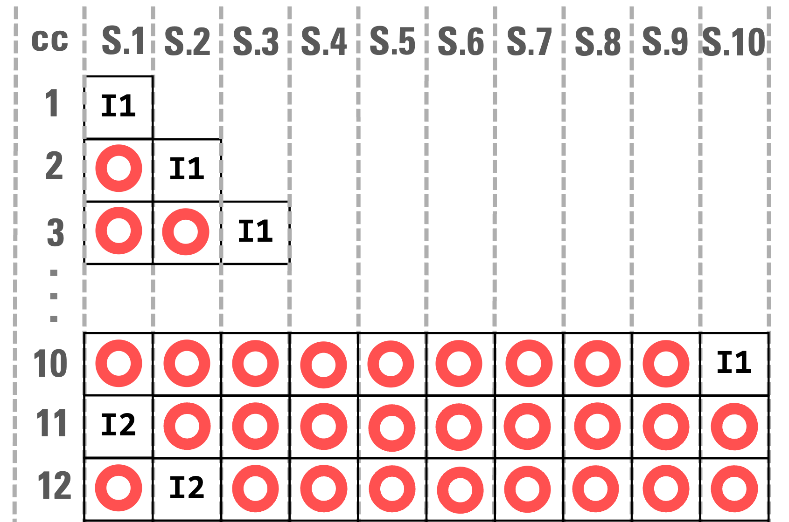
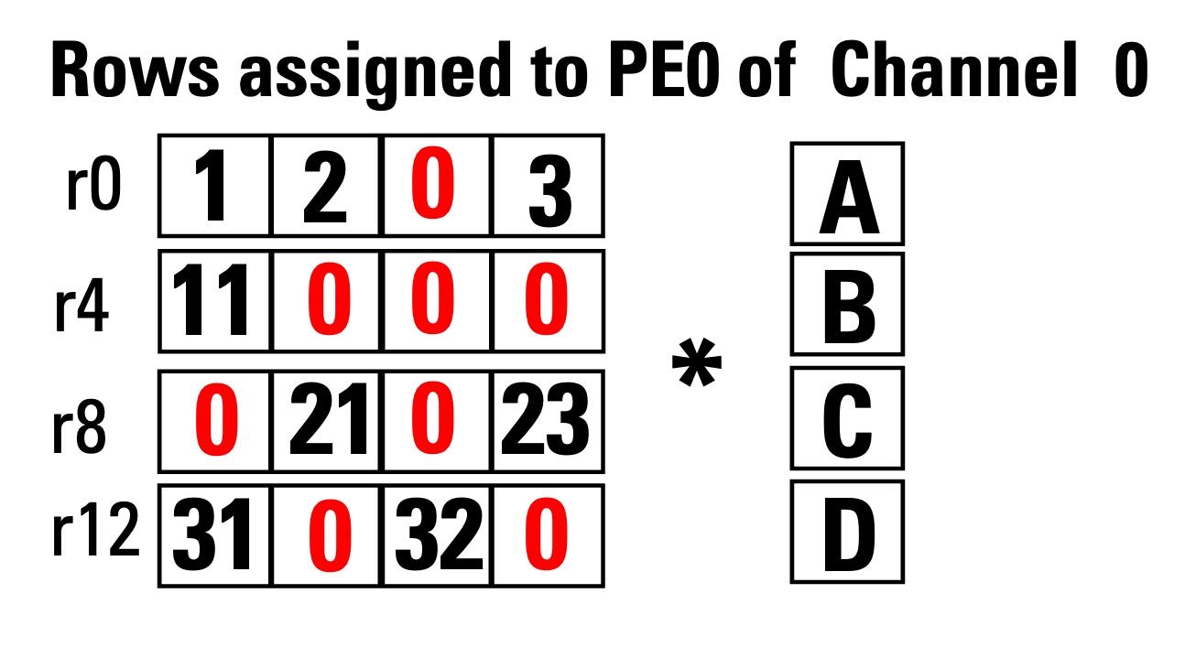

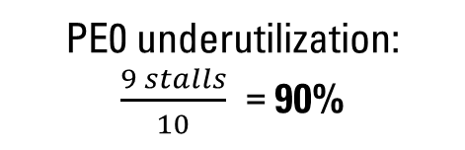
Row-based Non-zero Scheduling*
Naïve non-zero scheduling method
Throughput:
0.10 non-zeros per cycle
PE0 underutilization: $\frac{9 stalls}{10}$ = 90%
PE0 of Channel 0 Instructions:
I1:
I2:
I3:
r0_op1 = 1A
r0_op2 = 2B +r0_op1
r0_op3 = 3D +r0_op2
RAW
. . .
. . .
RAW
Legend:
cc: cycle
S.x: Stage x
NOP
Title:
Chasoň
*B.Su et.al clSpMV ICS 2012
Speaker:
Ubaid Bakhtiar
Notes:
One of the most naïve way of scheduling data in the memory or equivalently on the compute engines is Row-Based Non-Scheduling.
In Row-based scheduling the rows are assigned to the Pes based on the modulo of Row Id with Total Number of PEs.
In this example if we have 4 Pes associated with HBM channel 0 then the rows assigned to 0th PE shall be R0, R4, R8 and so on.
The corresponding instruction will look like this.

Slide 11
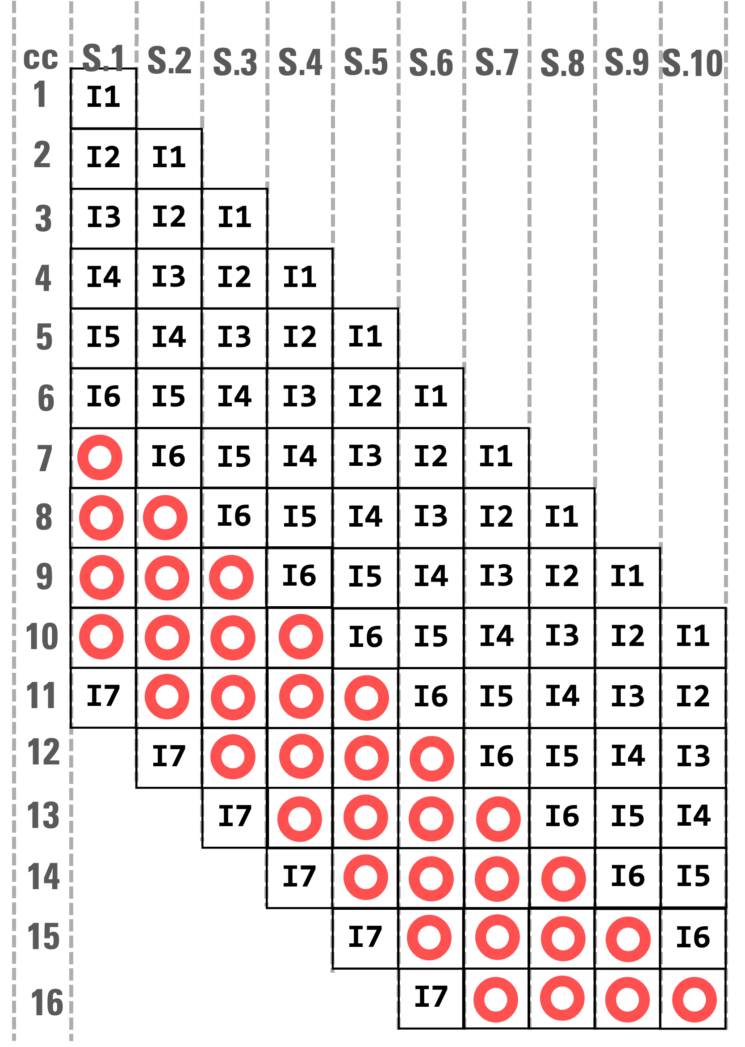
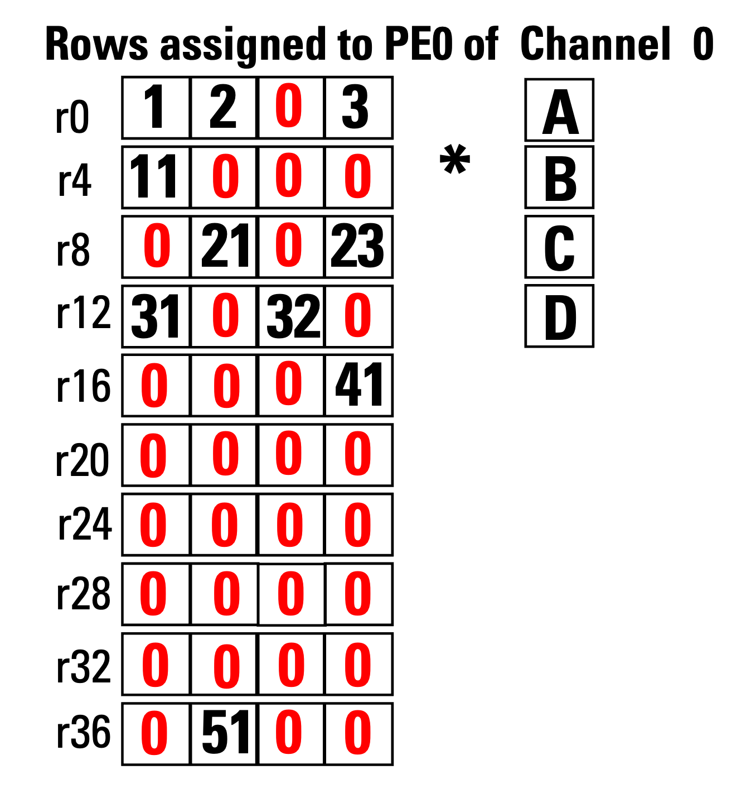
PE-Aware Non-zero Scheduling*
State-of-the-art non-zero scheduling method
PE0 of Channel 0 Instructions:
I1:
I2:
I3:
I4:
I5:
I6:
r0_op1 = 1A
r4_op1 = 11A
r8_op1 = 21B
r12_op1 = 31A
r16_op1 = 41D
r36_op1 = 51B
Title:
Chasoň
*L. Song et.al Serpens DAC 2022
Speaker:
Ubaid Bakhtiar
Notes:
This inefficiency has been addressed by the state-of-the-art non-zero scheduling method called PE-aware Non-zero Scheduling.
In this scheduling shceme, instead of scheduling all the instructions of one row before moving on to the next, it follows a cyclic assignment.
In other words, the first instruction will correspond to row 0, the second instruction will correspond to row 4.
But there is a problem, after the scheduling the 6th instruction, there are no more non-zeros to schedule from a new row. So the instruction from row 0 is instead scheduled

Slide 12

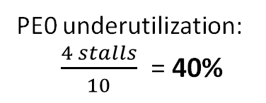
PE-Aware Non-zero Scheduling*
State-of-the art non-zero scheduling method
Throughput:
0.60
PE0 underutilization:
$\frac{4 stalls}{10}$ = 40%
PE0 of Channel 0 Instructions:
I1:
I2:
I3:
I4:
I5:
I6:
r0_op1 = 1A
r4_op1 = 11A
r8_op1 = 21B
r12_op1 = 31A
r16_op1 = 41D
r36_op1 = 51B
RAW
I7:
r0_op2 = 2B +r0_op1
Title:
Chasoň
*L. Song et.al Serpens DAC 2022
Speaker:
Ubaid Bakhtiar

Slide 13
PE Underutilization using PE-Aware Scheduling
PE underutilization % in 800 SuiteSparse matrices (lower is better)
Goal: Move the curve as far to the left as possible
Title:
Chasoň
Speaker:
Ubaid Bakhtiar
Notes:
With the majority of workloads being 69% underutilized
But the question is why should we care about PE underutilization?

Slide 14

Post-Moore’s Law
Slowing down of transistor scaling
Resource Utilization Gap
Need for Efficiency
Diverse Domain-Specific Challenges
Title:
Chasoň
Speaker:
Ubaid Bakhtiar
Notes:
To answer this question lets go through a brief overview of the state of things post moore’s law era.
1. The traditional scaling of transistor density is slowing down, making it harder to rely on technology scaling for performance improvements.
2. Despite the advancements in computational power, modern supercomputers like Fugaku and Frontier achieve only a fraction of their theoretical peak performance (e.g., 3.6% and 1.1% in HPCG benchmarks, 2023).
3. This inefficiency highlights a critical challenge: the need to optimize resource utilization and reduce underutilization of processing elements (PEs).
4. Real-world applications across domains—ranging from machine learning and data analytics to physics simulations and financial modeling—demand smarter resource management for better performance.
5. This means that improving computational throughput now depends more on smart architecture and efficient use of resources rather than raw hardware scaling.
I just put this cartoon that pretty much shows what is the state of affairs right now and what the whole motivation of this presentation is.

Slide 15
Key Insight
“To reduce the number of stalls and resource underutilization in a PE associated with an HBM channel, we can schedule the instructions from a PE of a neighboring channel in the current PE. This is made possible by migrating the values from across HBM channels in the scheduling step and providing relevant architectural support.”
Title:
Chasoň
Speaker:
Ubaid Bakhtiar

Slide 16
Chasoň - Scheduling
Title:
Chasoň
Speaker:
Ubaid Bakhtiar

Slide 17
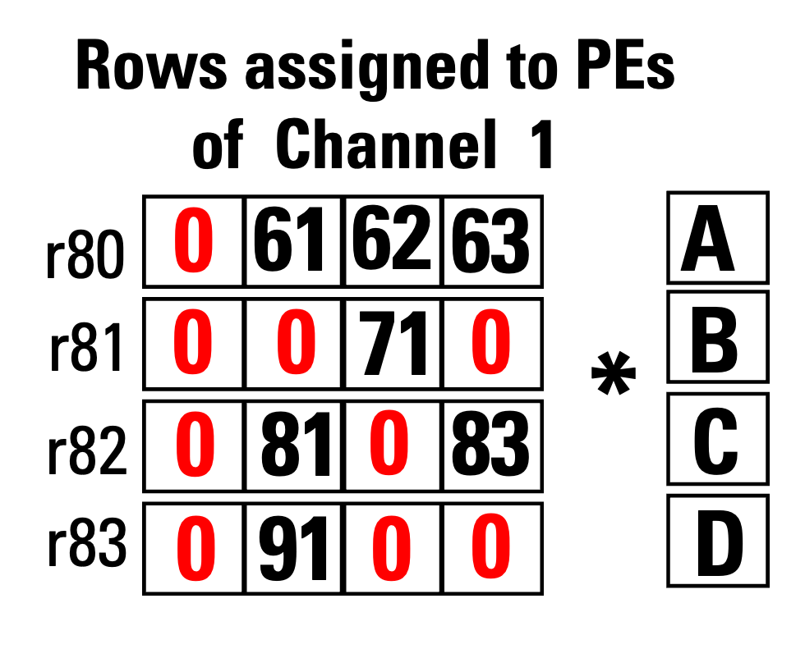
Cross-HBM Channel OoO Scheduling (CrHCS)
CrHCS is our proposed scheduling scheme
PE0 of Channel 1 instructions:
i8:
i9:
i10:
i11:
r80_op1_sh =61A
r81_op1_sh =71C
r82_op1_sh =81B
r83_op1_sh =91B
CrHCS schedule these instructions to the PEs of Channel 0
Pipeline of PE-aware Non-zero Scheduling
Title:
Chasoň
Speaker:
Ubaid Bakhtiar
Notes:
Now lets assume these are the rows assigned to the PEs associated with Channel 1.
And the corresponding instructions are as follows.

Slide 18
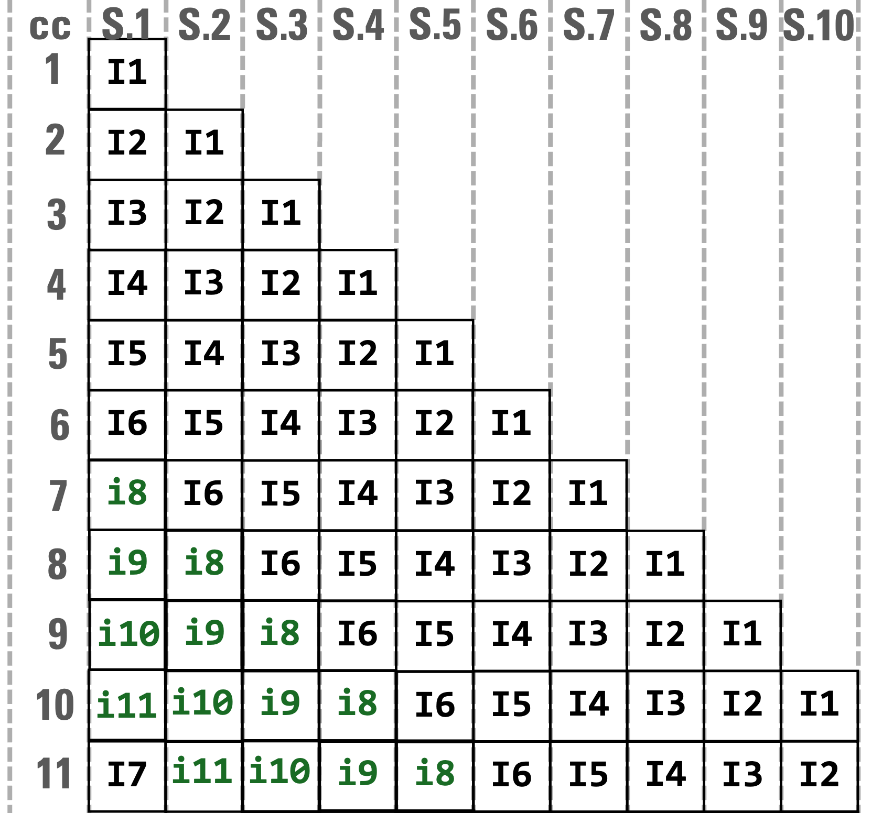
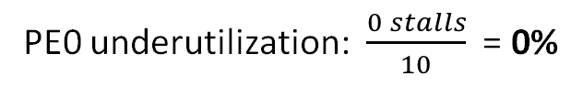
Cross-HBM Channel OoO Scheduling (CrHCS)
CrHCS is our proposed scheduling scheme
Throughput:
1 non-zero per cycle
PE0 underutilization: $\frac{0 stalls}{10}$ = 0%
PE0 of Channel 1 instructions:
i8:
i9:
i10:
i11:
r80_op1_sh =61A
r81_op1_sh =71C
r82_op1_sh =81B
r83_op1_sh =91B
CrHCS schedule these instructions to the PEs of Channel 0
Pipeline of CrHCS
Title:
Chasoň
Speaker:
Ubaid Bakhtiar

Slide 19
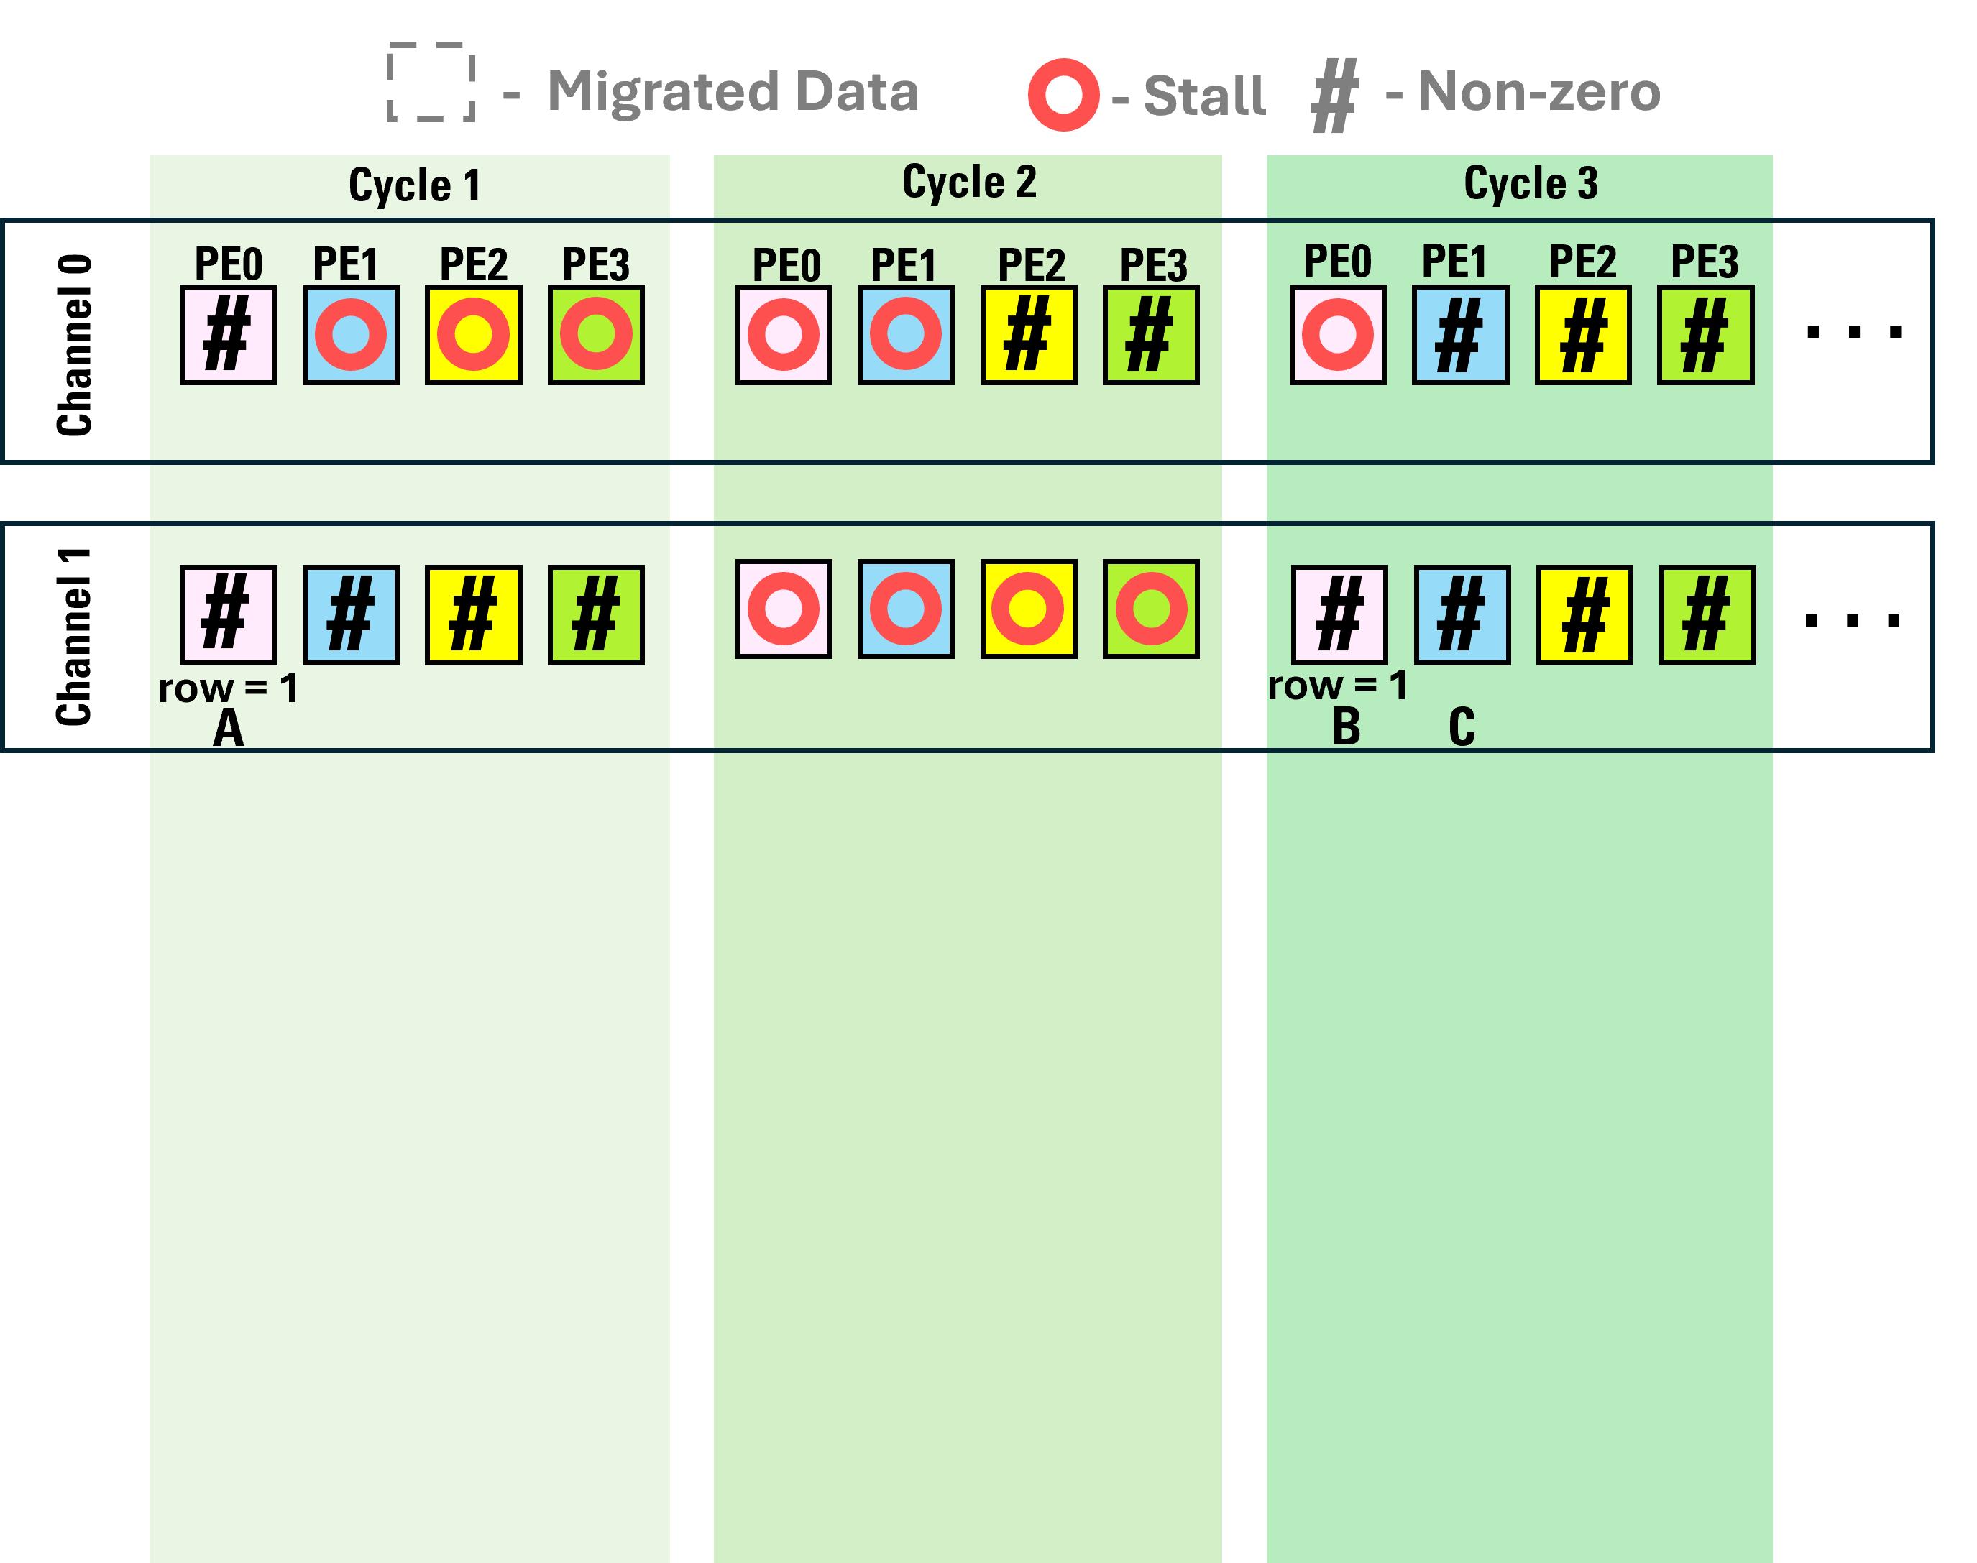
CrHCS – Mechanism
The key idea of our proposed scheduling scheme, CrHCS, is to incorporate cross-HBM channel data migration by migrating the non-zero values from a data list of one channel to the other
Title:
Chasoň
Speaker:
Ubaid Bakhtiar

Slide 20
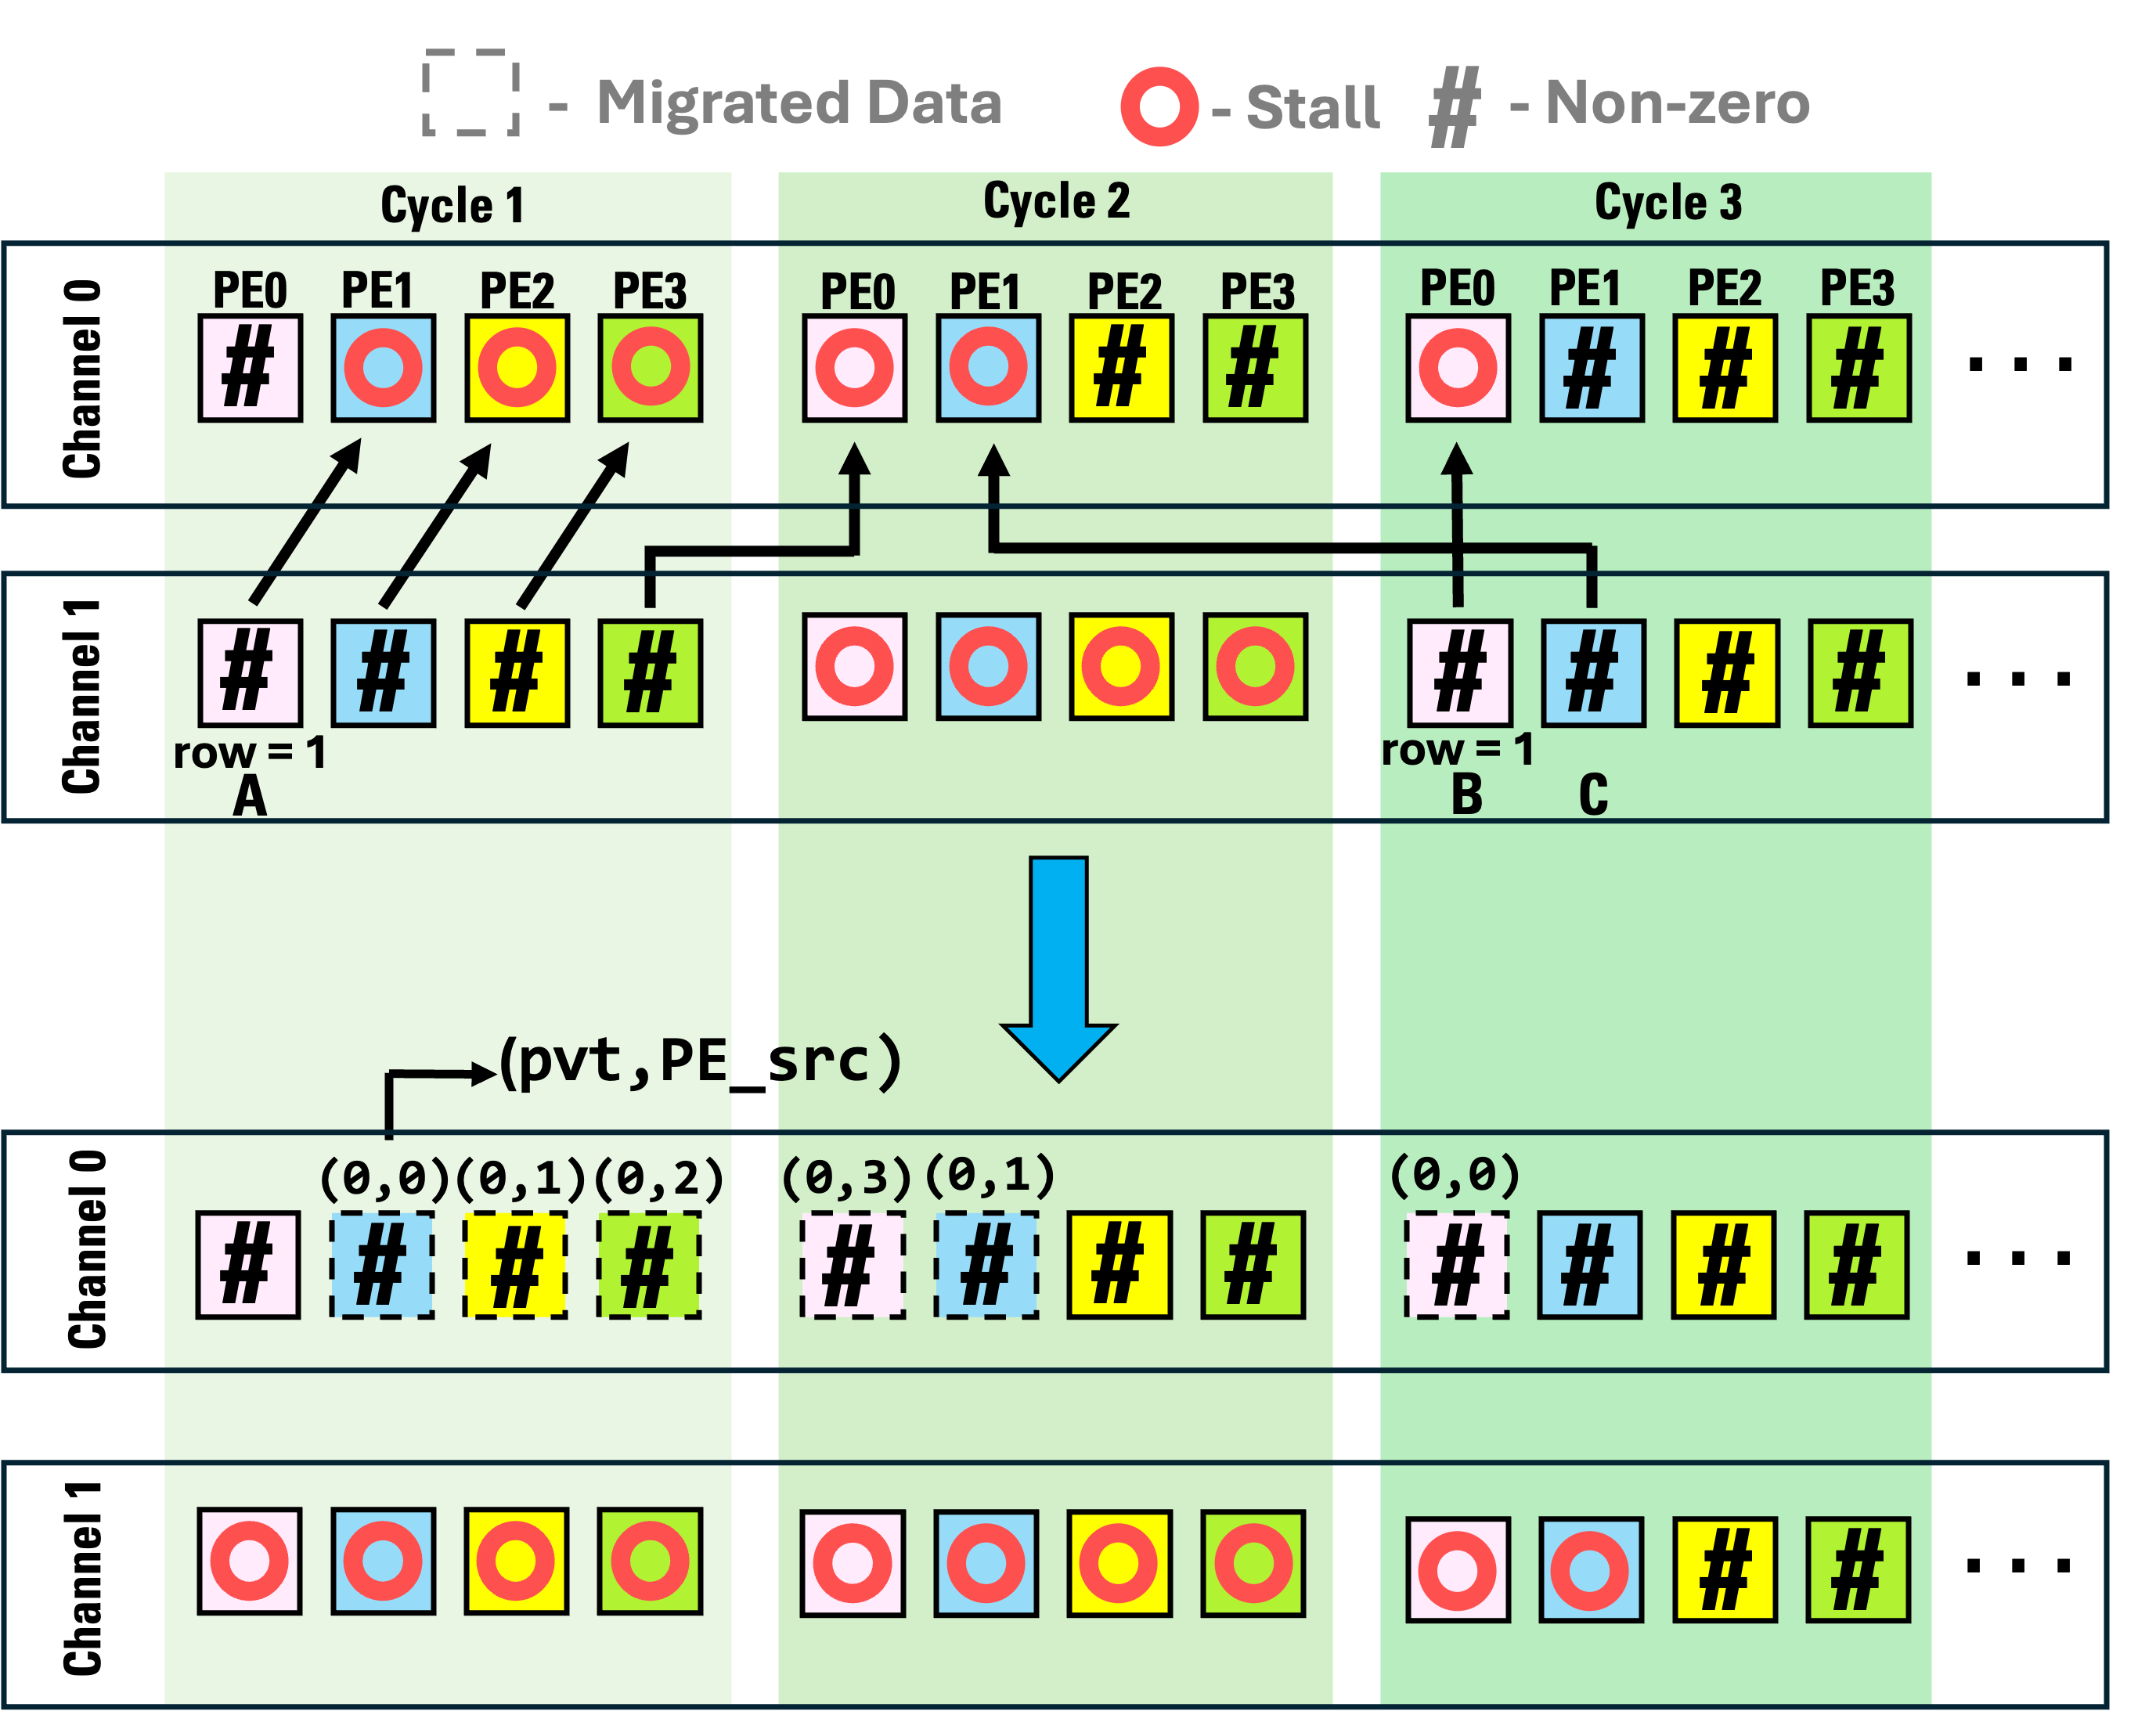
CrHCS – Mechanism
The key idea of our proposed scheduling scheme, CrHCS, is to incorporate cross-HBM channel data migration by migrating the non-zero values from a data list of one channel to the other
Title:
Chasoň
Speaker:
Ubaid Bakhtiar

Slide 21
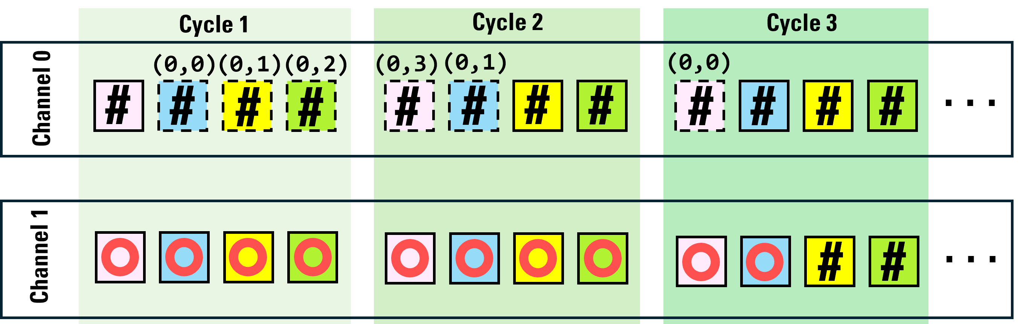
CrHCS – Mechanism
The key idea of our proposed scheduling scheme, CrHCS, is to incorporate cross-HBM channel data migration by migrating the non-zero values from a data list of one channel to the other
(pvt,PE_src)
Title:
Chasoň
Speaker:
Ubaid Bakhtiar
Notes:
The stalls in Channel 0 will be filled in by the non-zeros of channel 2 and so on.
CrHCS keeps track of the migrated data using pvt and PE_src flags. These flags are necessary to ensure the functional correctness of the architecture.
For details about the data structure used and how the RAW dependencies are handled in the migrated data, please refer to the full paper

Slide 22
Chasoň – Architectural Support
Title:
Chasoň
Speaker:
Ubaid Bakhtiar

Slide 23
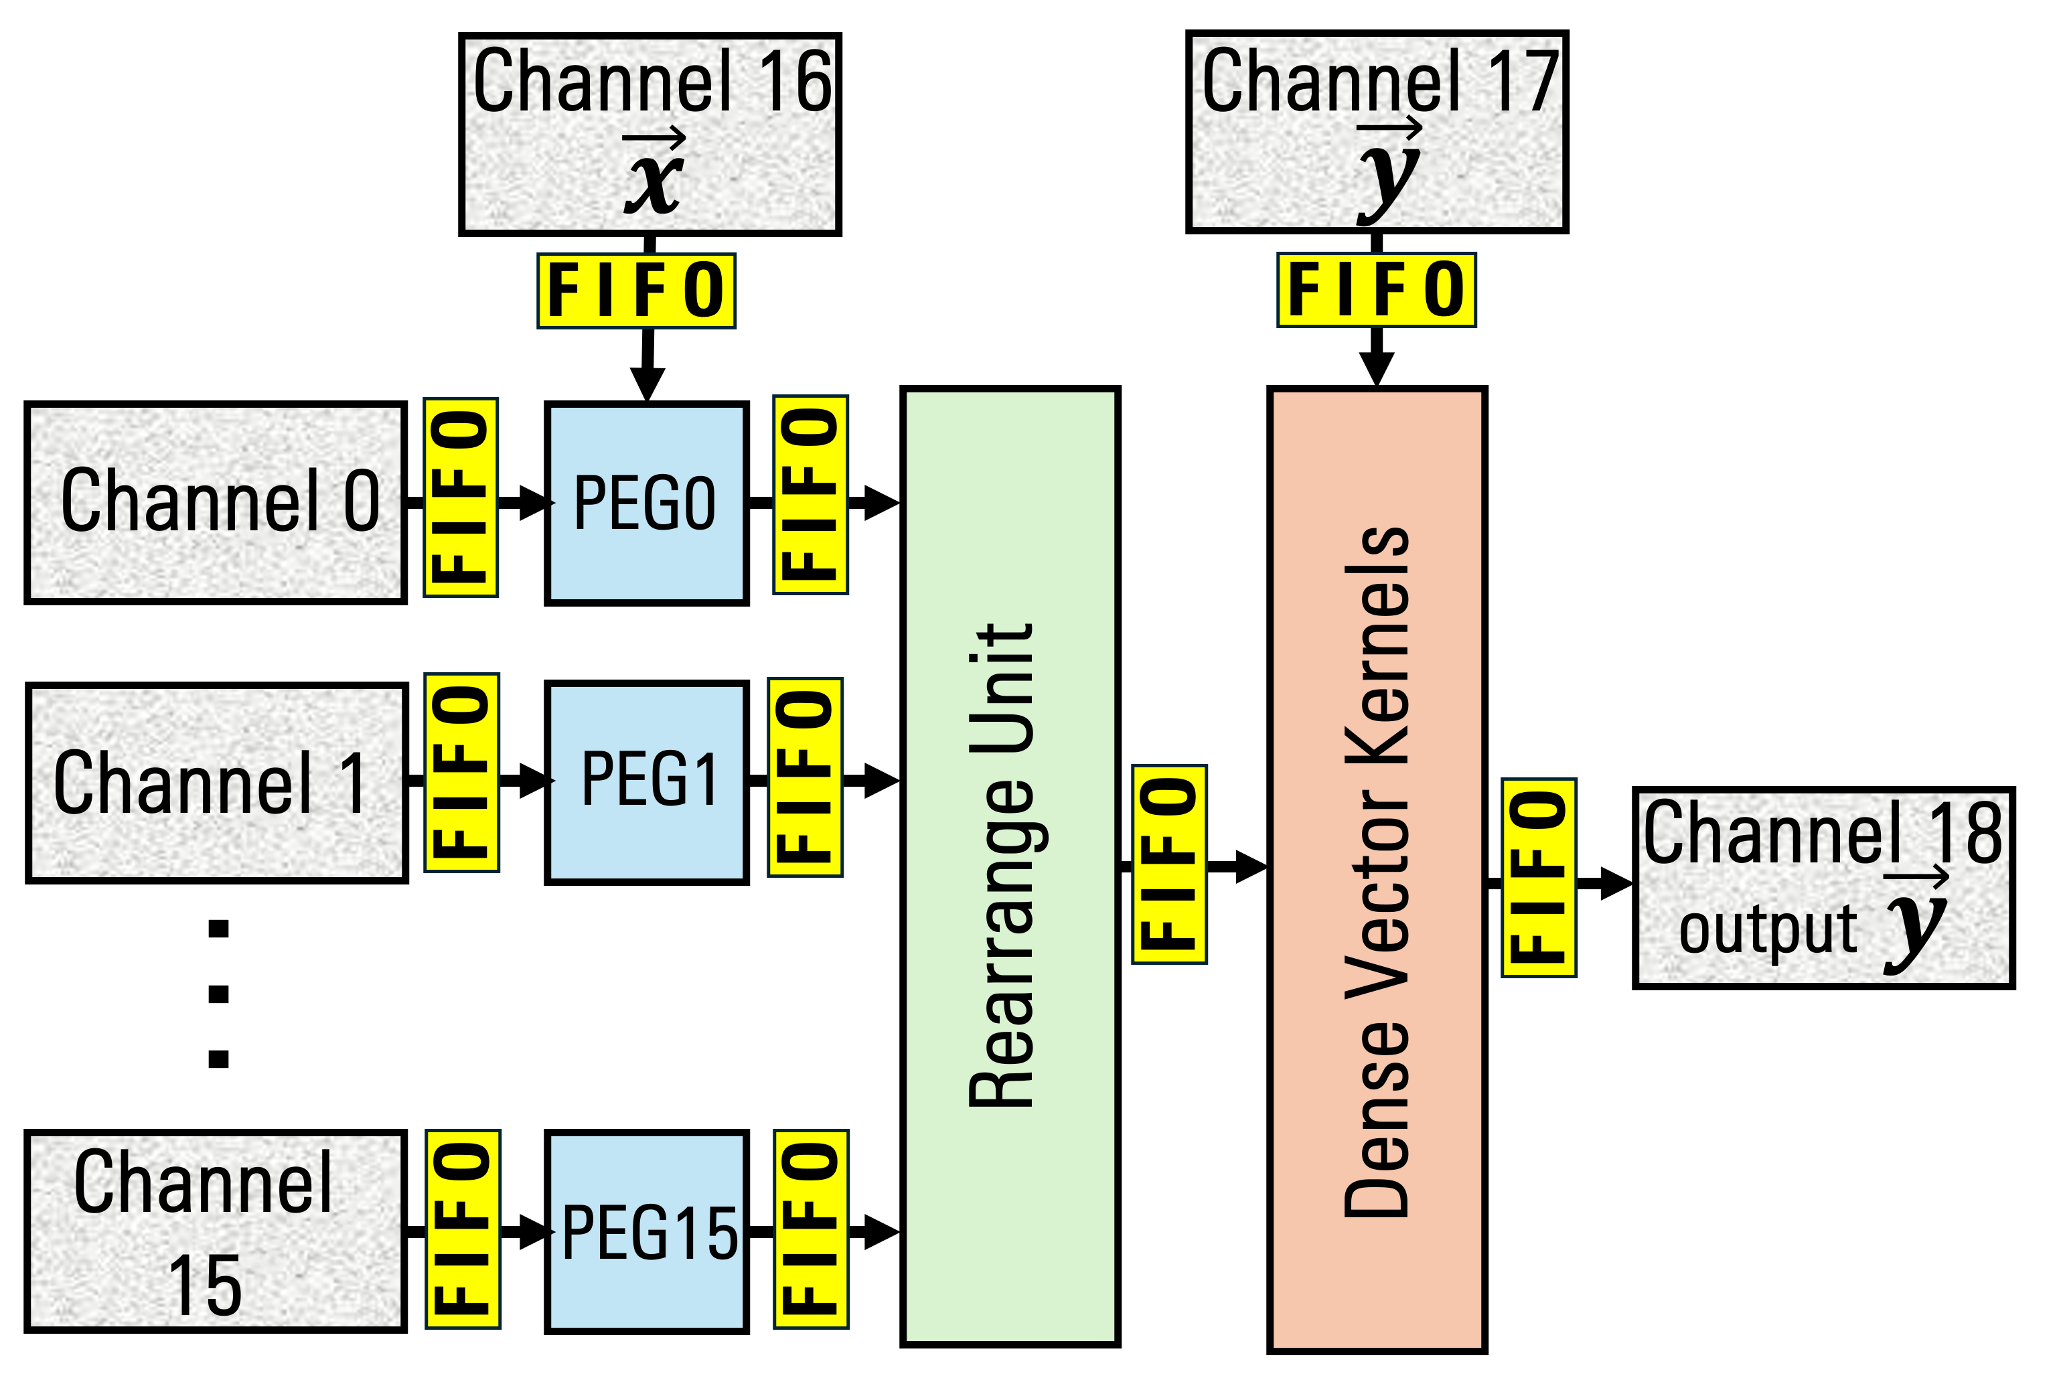
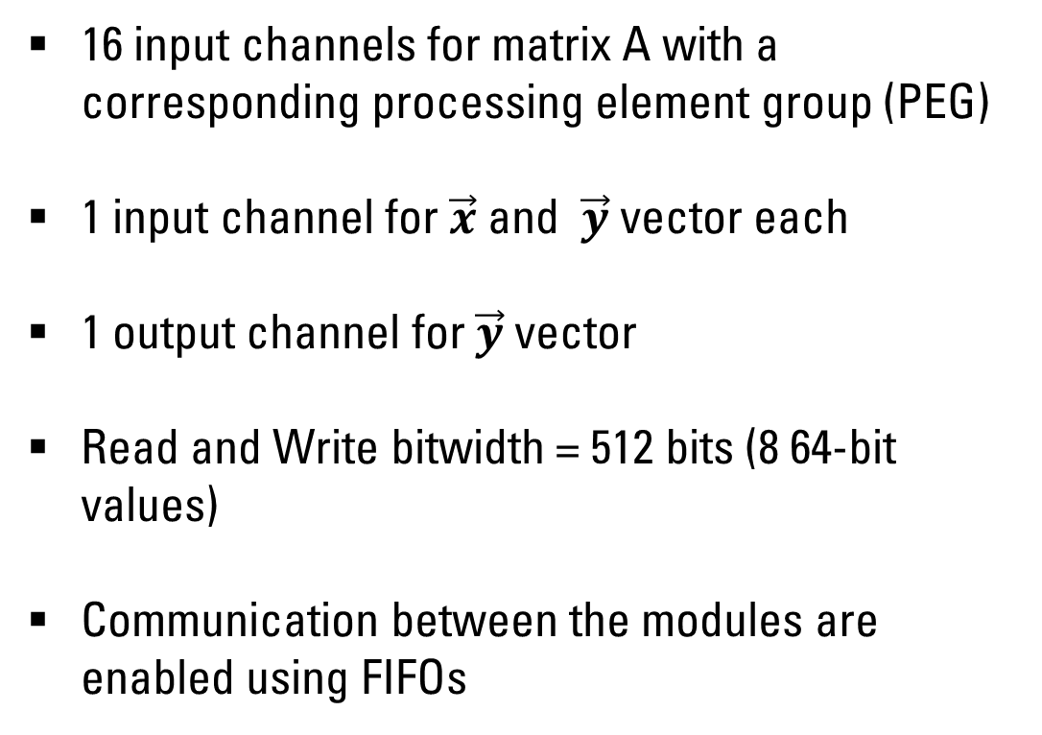
High-Level Overview
16 input channels for matrix A with a corresponding processing element group (PEG)
1 input channel for $\vec{x}$ and $\vec{y}$ vector each
1 output channel for $\vec{y}$ vector
Read and Write bitwidth = 512 bits (8 64-bit values)
Communication between the modules are enabled using FIFOs
. . .
Title:
Chasoň
Speaker:
Ubaid Bakhtiar
Notes:
To bring the cross-HBM channel out-of-order scheduling scheme into practice, we designed a dedicated accelerator

Slide 24
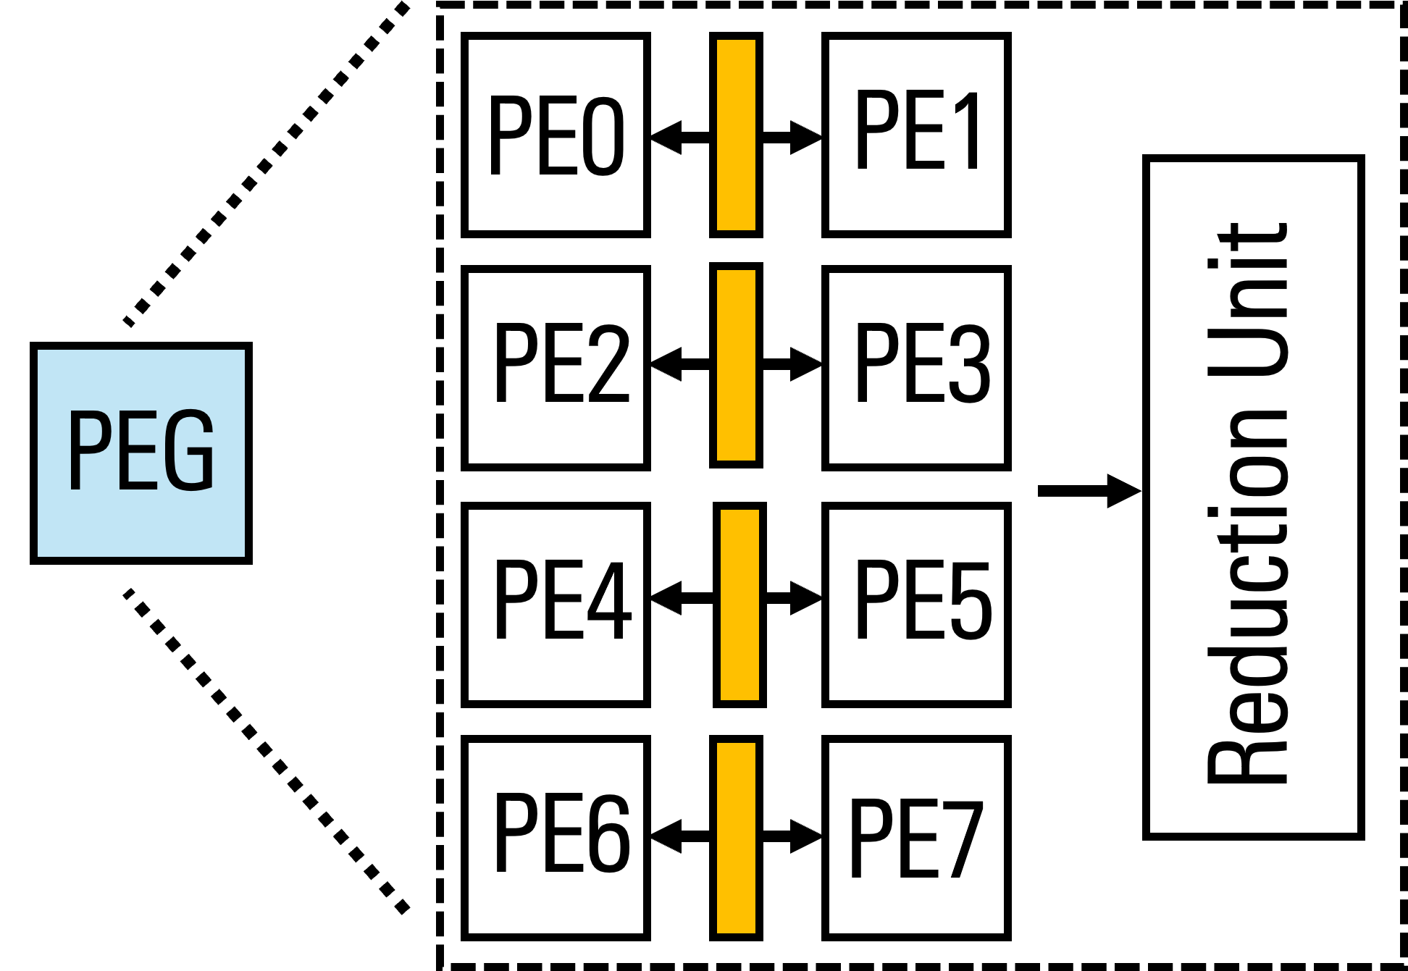
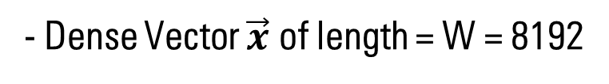
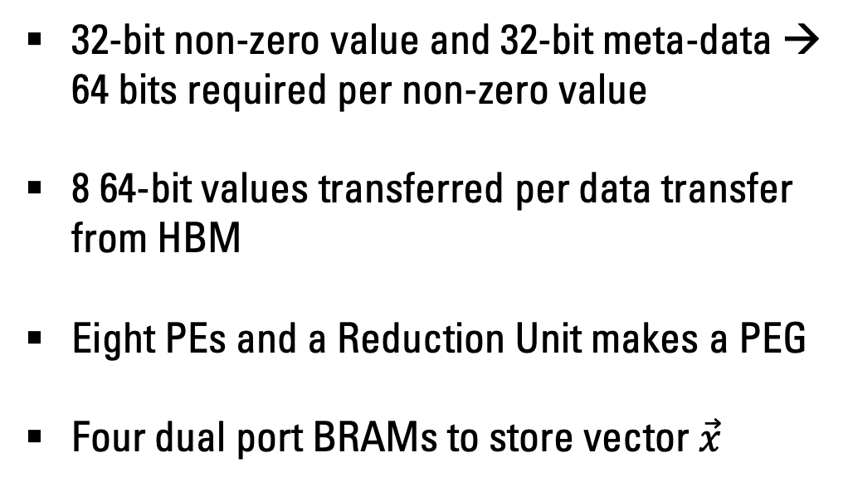
Architecture of a PEG
BRAM
- Dense Vector $\vec{x}$ of length = W = 8192
32-bit non-zero value and 32-bit meta-data → 64 bits required per non-zero value
8 64-bit values transferred per data transfer from HBM
Eight PEs and a Reduction Unit makes a PEG
Four dual port BRAMs to store vector $\vec{x}$
Title:
Chasoň
Speaker:
Ubaid Bakhtiar
Notes:
Chason is designed to handle computations on FP32 values with 32-bits of compression meta-data

Slide 25
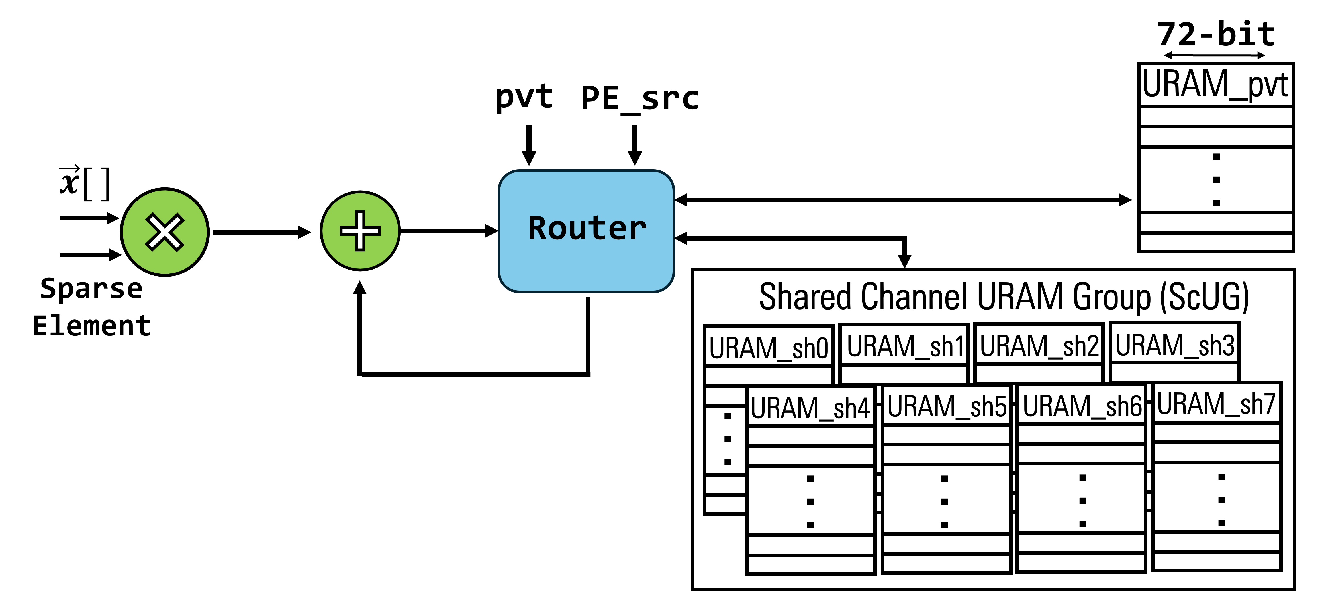
Architecture of a PE
The partial sums of private and shared channel values are placed in different URAMs
This is enabled using the pvt and PE_src flags in router
These partial sums are reduced using the Reduction Unit
Title:
Chasoň
Speaker:
Ubaid Bakhtiar
Notes:
We have router unit that uses pvt and PE_src fflags to route the partial outputs from the correct on-chip memory which is a URAM in our architecture.
If the MAC operation was done for migrated data then the router will fetch the values from the Shared Channel URAM group, else it will be fetched from the Private URAM

Slide 26
Experimental Setup
Title:
Chasoň
Speaker:
Ubaid Bakhtiar

Slide 27
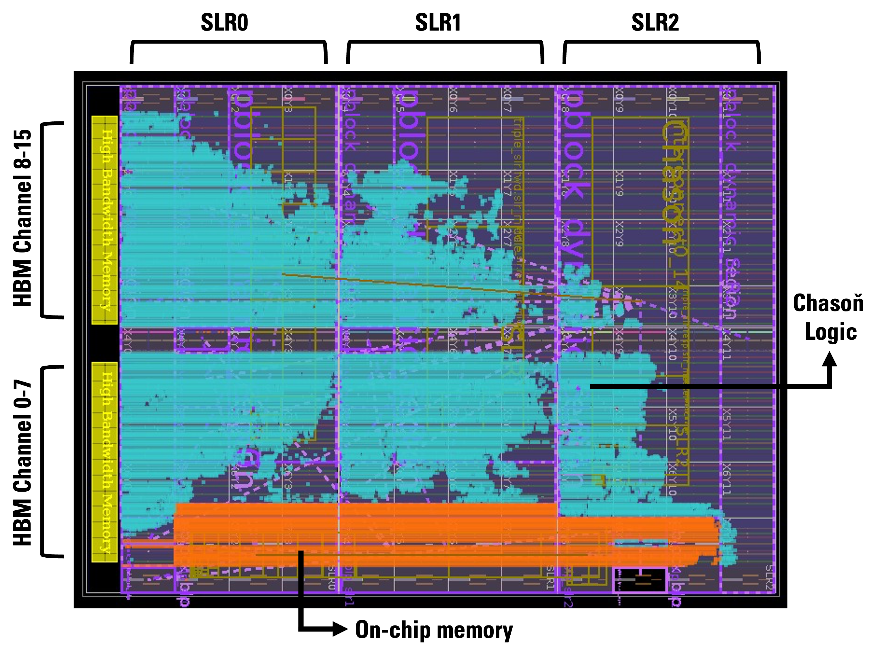
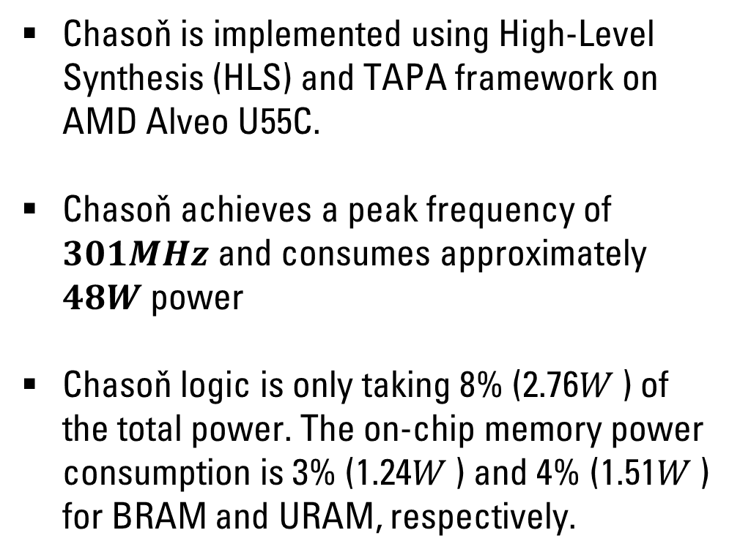
Hardware Implementation
Layout of Chasoň on AMD Alveo U55C
Chasoň is implemented using High-Level Synthesis (HLS) and TAPA framework on AMD Alveo U55C.
Chasoň achieves a peak frequency of $301MHz$ and consumes approximately $48W$ power
Chasoň logic is only taking 8% (2.76𝑊 ) of the total power. The on-chip memory power consumption is 3% (1.24𝑊 ) and 4% (1.51𝑊 ) for BRAM and URAM, respectively.
Title:
Chasoň
Speaker:
Ubaid Bakhtiar

Slide 28
Baselines
CPU Baseline
Intel Core i9-11980HK
Base frequency of 3.3GHz and 24MB Intel Smart Cache
Intel oneAPI Math Kernel Library (MKL) v2024.2.2
GPU Baseline
Nvidia RTX 4090 and Nvidia RTX 6000 Ada
24GB and 48GB of 384-bit GDDR6 memory
cuSPARSE Library on CUDA v10.1
FPGA Baseline
SOTA SpMV Accelerator: Serpens (uses PE-aware Non-zero Scheduling)
Bitstream generated for Alveo AMD U55C
Same level of parallelism as Chasoň to ensure fair comparison
Title:
Chasoň
Speaker:
Ubaid Bakhtiar

Slide 29
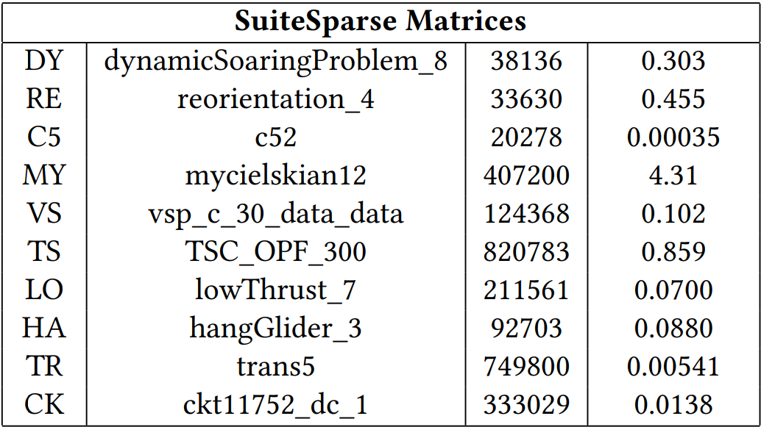
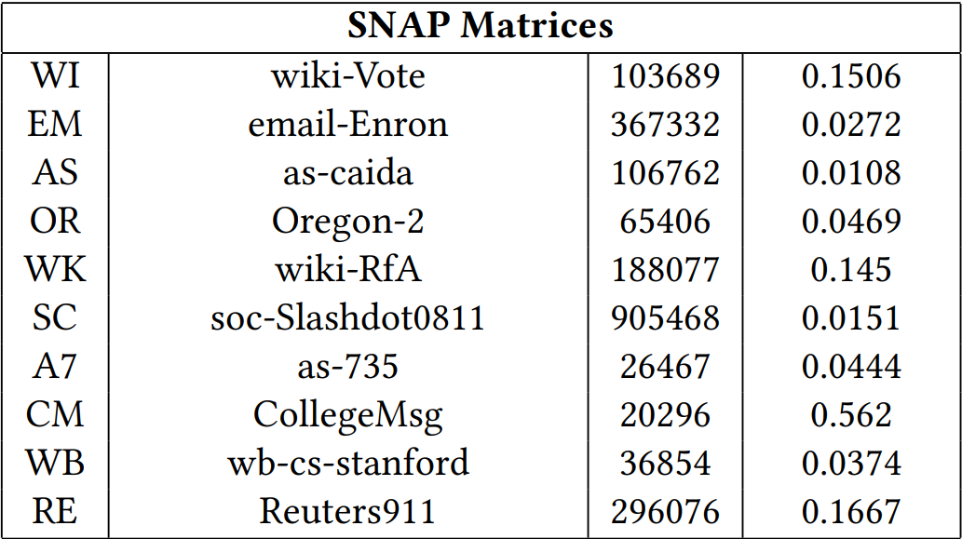
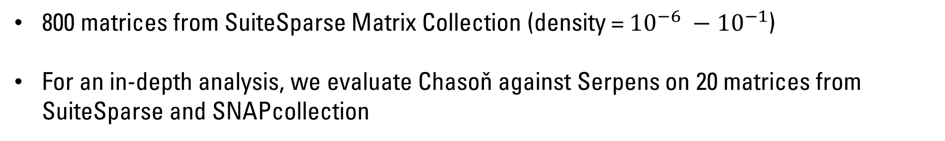
Dataset
800 matrices from SuiteSparse Matrix Collection (density = ${{10}^{−6} −10}^{−1}$)
For an in-depth analysis, we evaluate Chasoň against Serpens on 20 matrices from SuiteSparse and SNAPcollection
Title:
Chasoň
Speaker:
Ubaid Bakhtiar
Notes:
But should we care about resource underutilization ?

Slide 30
Evaluation
Title:
Chasoň
Speaker:
Ubaid Bakhtiar

Slide 31
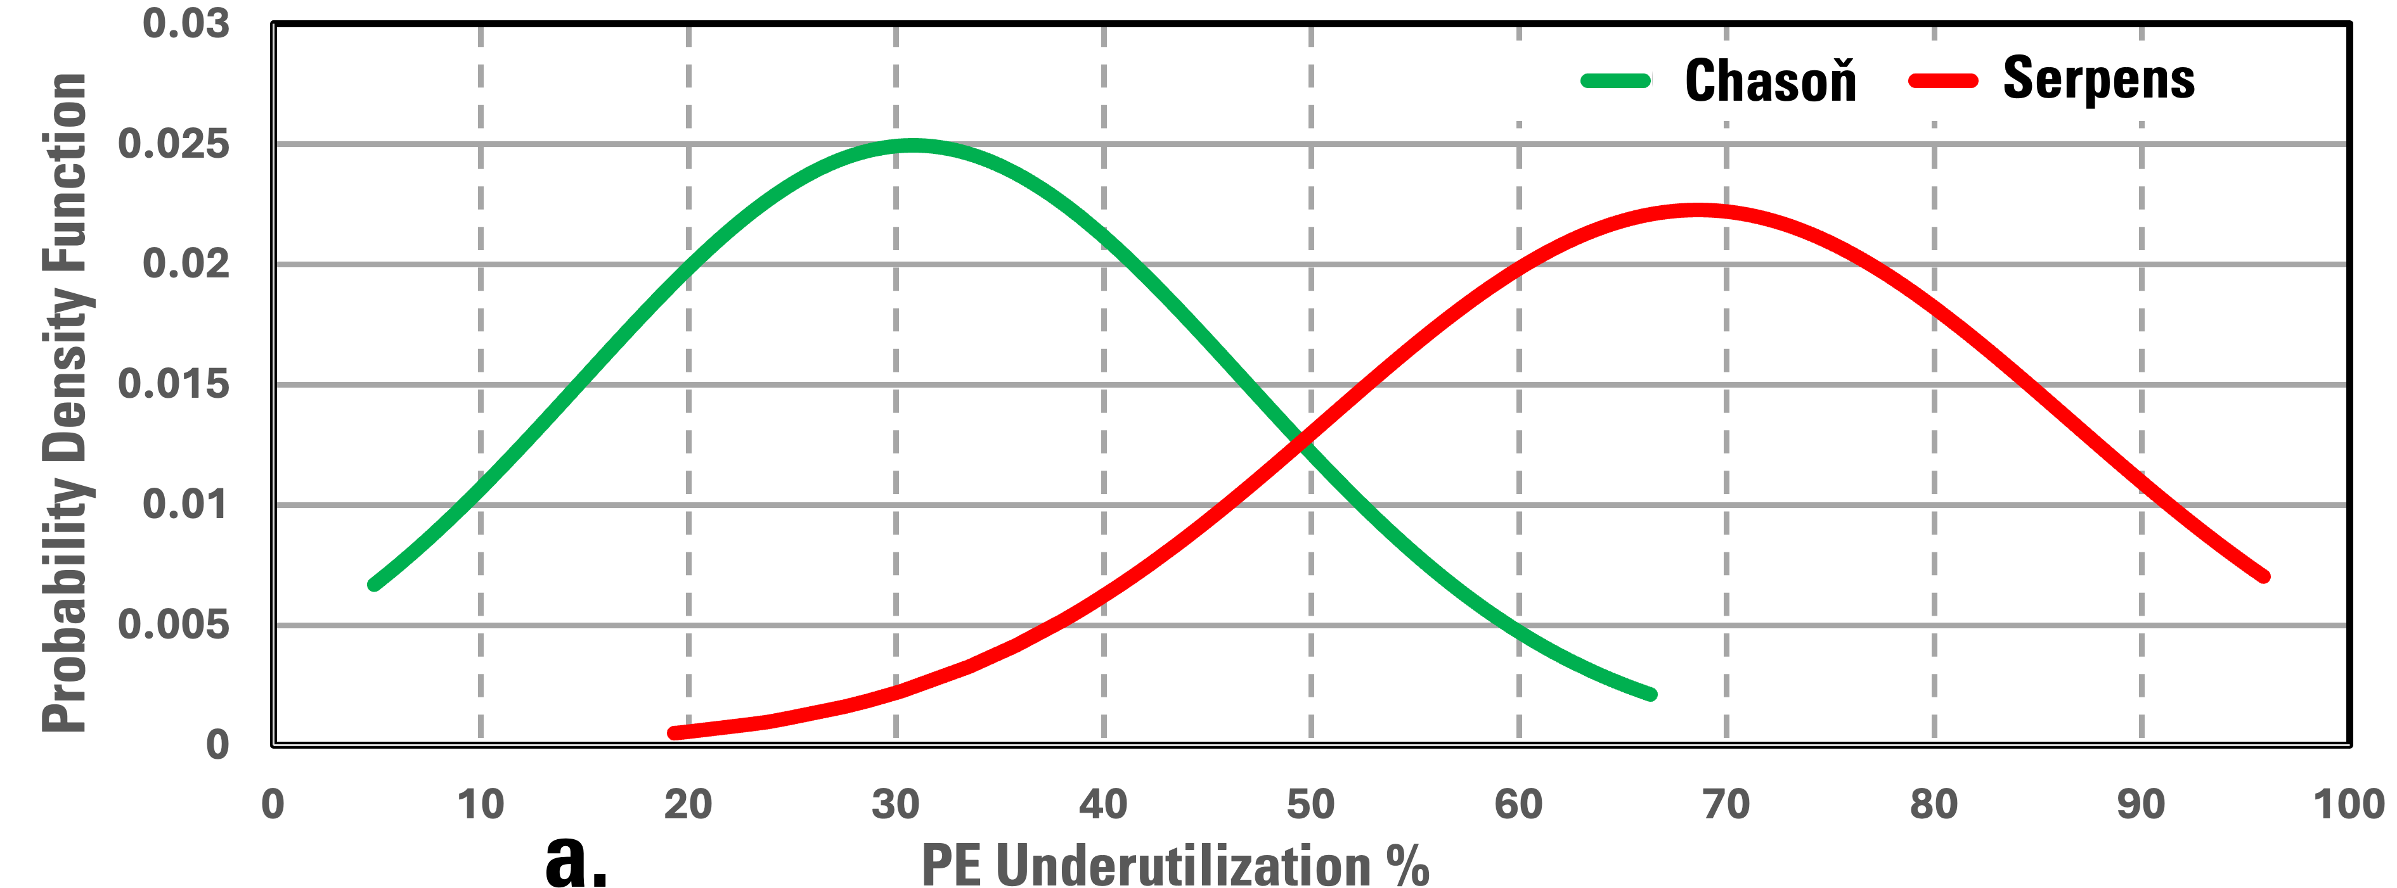
PE Underutilization
Serpens: High probability of PE underutilization > 50%, mode = 69%
Chasoň: High probability of PE underutilization < 50%, mode = 31%
PE underutilization % in 800 SuiteSparse matrices (lower is better)
Title:
Chasoň
Speaker:
Ubaid Bakhtiar
Notes:
This graph shows that most of the workloads in Serpens are underutilized by more than 50% with most workloads underutuilized by 69% While for Chason, majority of the workloads lies within the less than 50% PE underutilization range

Slide 32
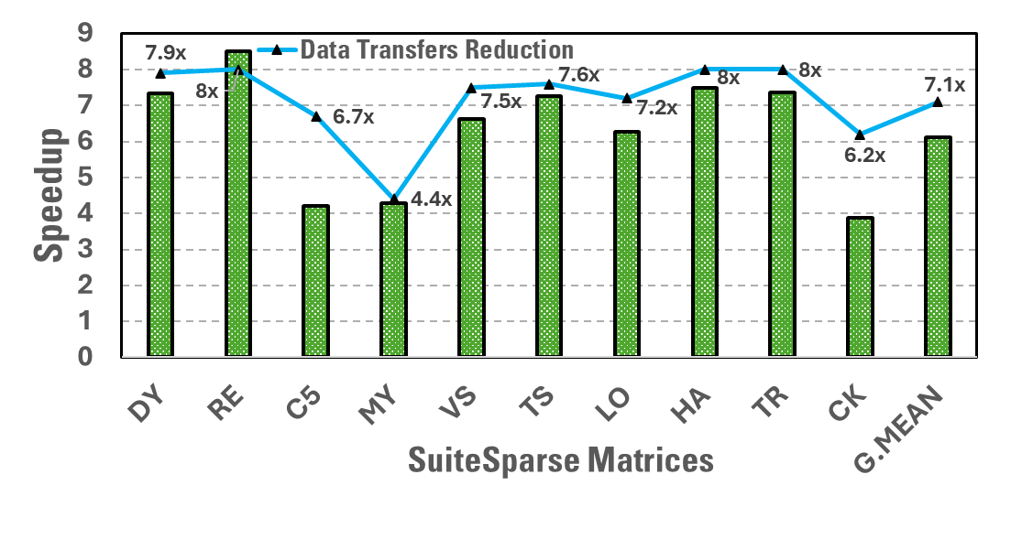
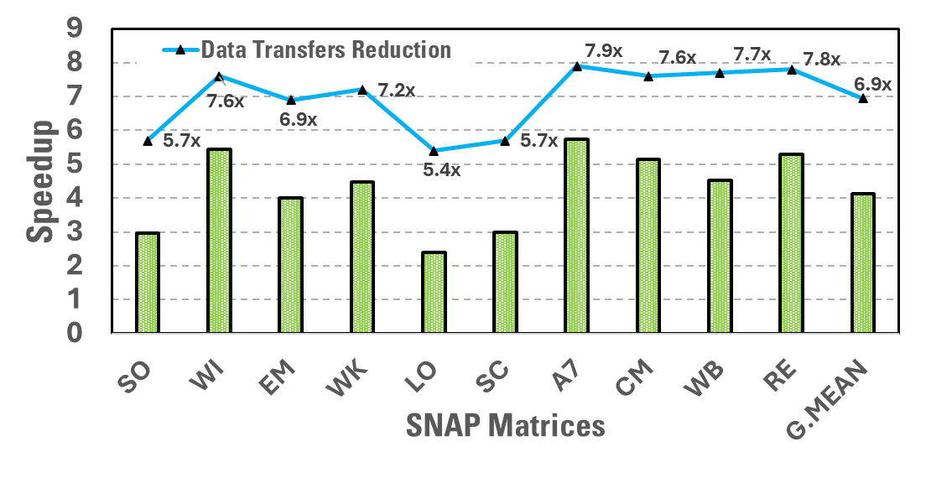
Improvement in Performance
Chasoň vs. Serpens:
One of the main reasons of Chasoň achieving speedup over Serpens is the data transfer reduction
Reducing the data transfers results in fewer PEG provocations
Title:
Chasoň
Speaker:
Ubaid Bakhtiar
Notes:
On Average Chason achieves 7x speedup over Serpens.
One of the primary reasons of speedup is the data movement reduction between HBM and processing element groups.
Or in other words, fewer provocations of PEGs are required to do the computations

Slide 33
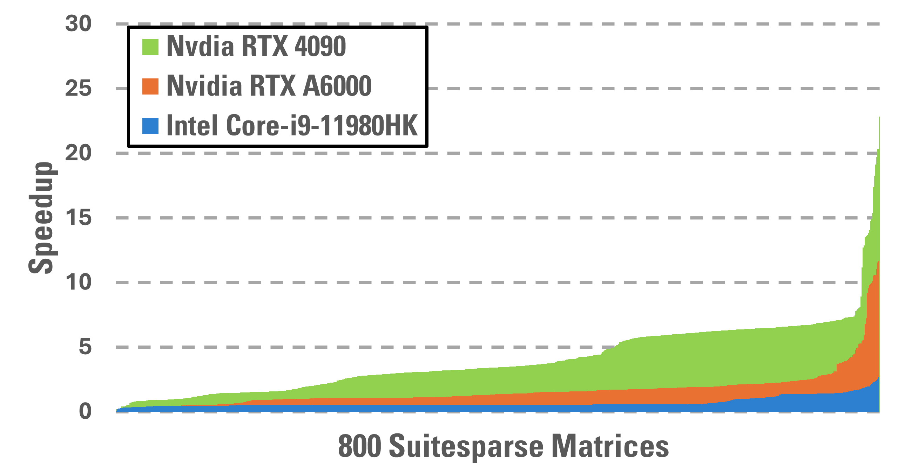
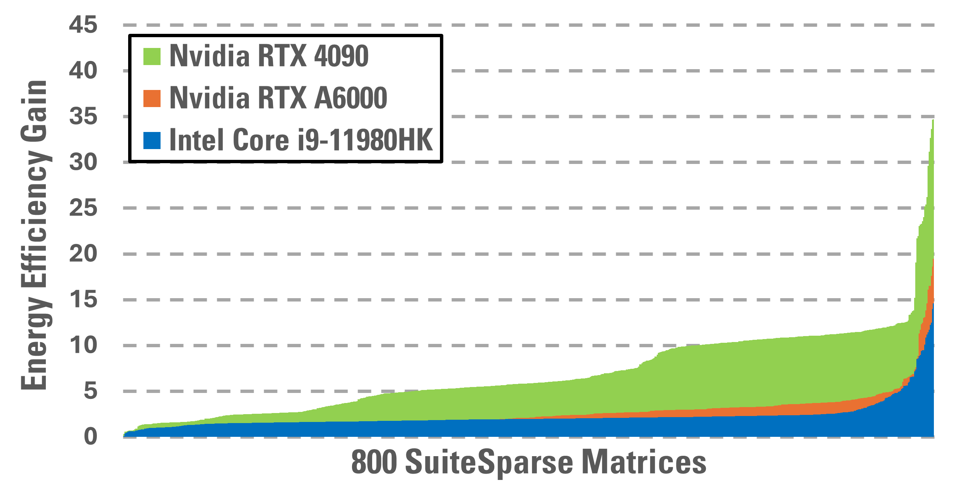
Improvement in Performance
Chasoň vs. CPU & GPUs
On average Intel Core i9, Nvidia RTX 4090, RTX 6000 Ada consume 132W, 70W and 65W respectively vs. Chasoň’s 48.7W power
Speedup
Energy Efficiency Gain
Peak Speedup: 20.33
Peak Gain: 34.72
Peak Speedup: 11.65
Peak Gain: 19.48
Peak Gain: 14.61
Peak Speedup: 2.67
Title:
Chasoň
Speaker:
Ubaid Bakhtiar

Slide 34
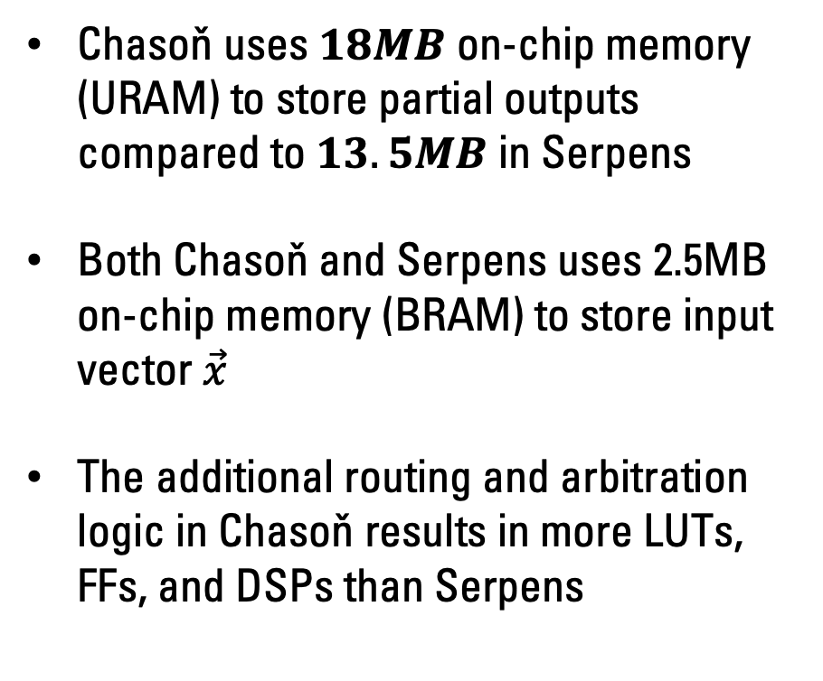
Resource Consumption
Chasoň uses $18MB$ on-chip memory (URAM) to store partial outputs compared to $13.5MB$ in Serpens
Both Chasoň and Serpens uses 2.5MB on-chip memory (BRAM) to store input vector $\vec{x}$
The additional routing and arbitration logic in Chasoň results in more LUTs, FFs, and DSPs than Serpens
AMD Alveo U55C Resource Consumption for Chasoň & Serpens
 | Architecture
 | Serpens | Chasoň
LUT | 219K (16%) | 346K (26%)
FF | 252K (9.6%) | 418K (16%)
DSP | 798 (9.6%) | 1254 (13%)
BRAM18K | 1024 (28%) | 1024 (28%)
URAM | 384 (40%) | 512 (52%)
Title:
Chasoň
Speaker:
Ubaid Bakhtiar

Slide 35
Conclusions
Title:
Chasoň
Speaker:
Ubaid Bakhtiar

Slide 36


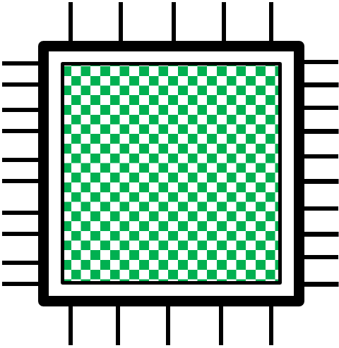
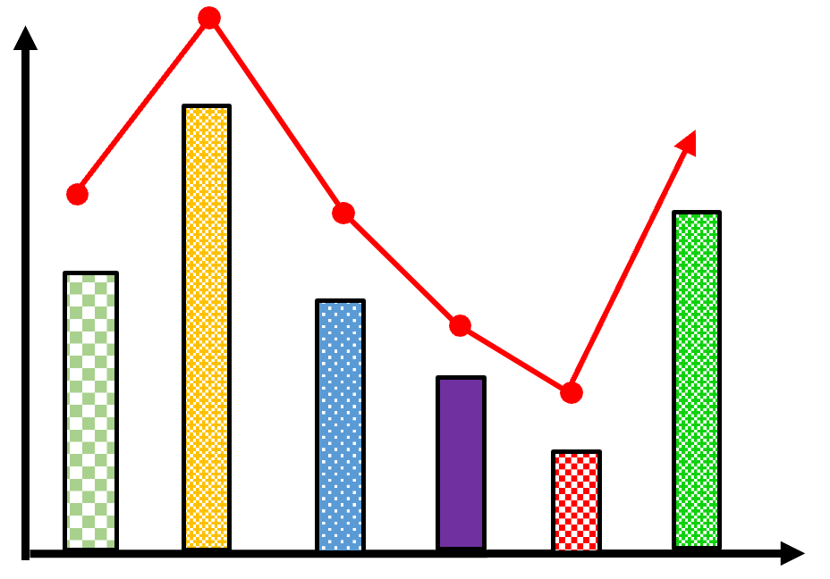
Sparsity is a prevalent topic in scientific computing as well as generative AI
HBMs are being employed widely to mitigate the memory bottlenecks of sparse kernels owing to their high bandwidth and low energy cost
Existing sparse kernel accelerators are highly underutilized owing to sub-optimal data scheduling on to the processing elements
Our novel scheduling scheme, CrHCS, mitigates the resource underutilization by allowing cross-HBM channel data migration
To support CrHCS, we develop Chasoň, an FPGA-based SpMV accelerator on AMD Alveo U55C. Chason achieves 301MHz frequency and consumes 48W power
Chasoň achieves substantial improvement in resource underutilization and performance
Title:
Chasoň
Speaker:
Ubaid Bakhtiar

Slide 37


Thank You !!!
Questions and comments are welcomed.
We thank the United States Department of Energy (DoE) and National Science Foundation (NSF) for supporting this project
Title:
Chasoň
Speaker:
Ubaid Bakhtiar

Slide 38
Extras
Title:
Chasoň
Speaker:
Ubaid Bakhtiar

Slide 39
CrHCS – Mechanism
Key Idea: The key idea of our proposed scheduling scheme, CrHCS, is to incorporate cross-HBM data migration to improve the PE utilization by migrating the non-zero values from a data list of one channel to the other.
CrHCS must keep track of:
The assigned PE in the original/private channel. (using additional pvt, PE_src flags)
Must respect the RAW dependency in the migrated data
Title:
Chasoň
Speaker:
Ubaid Bakhtiar

Slide 40
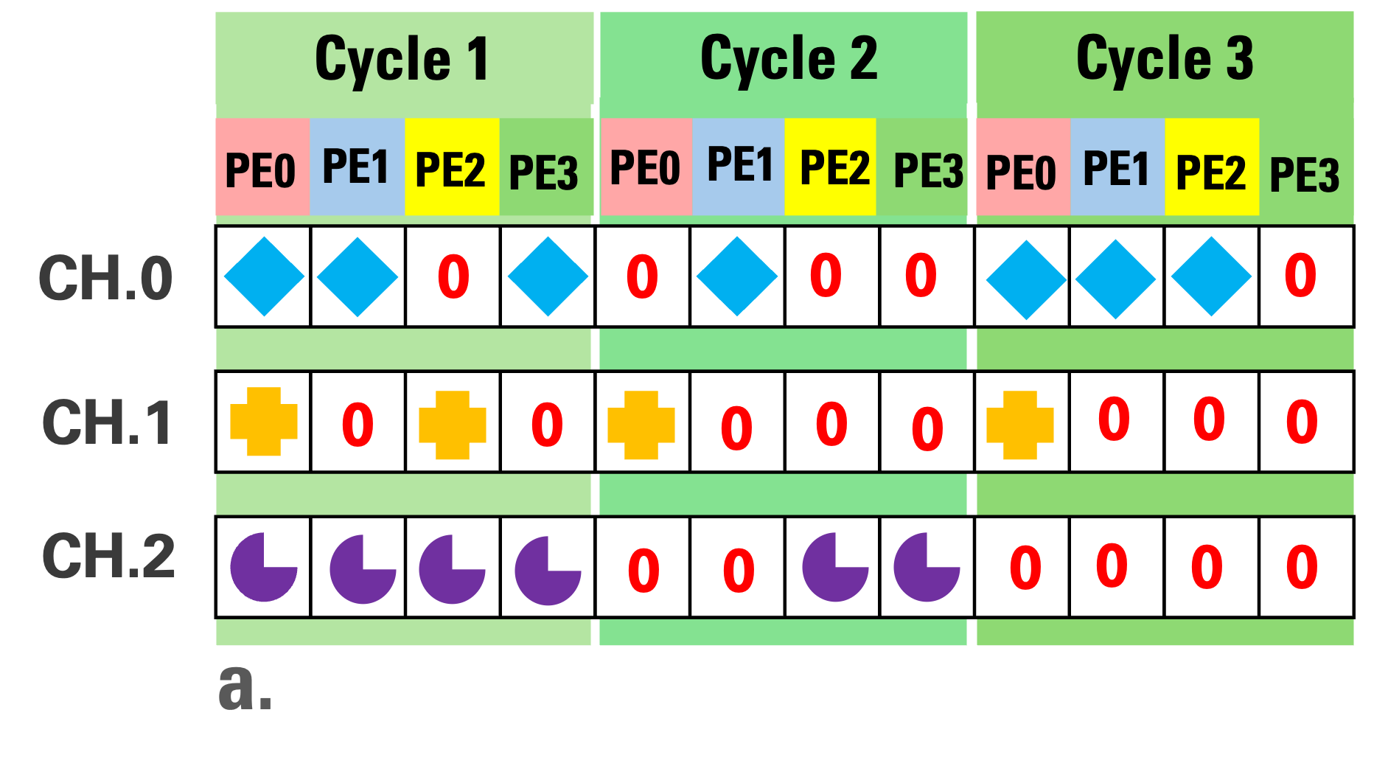
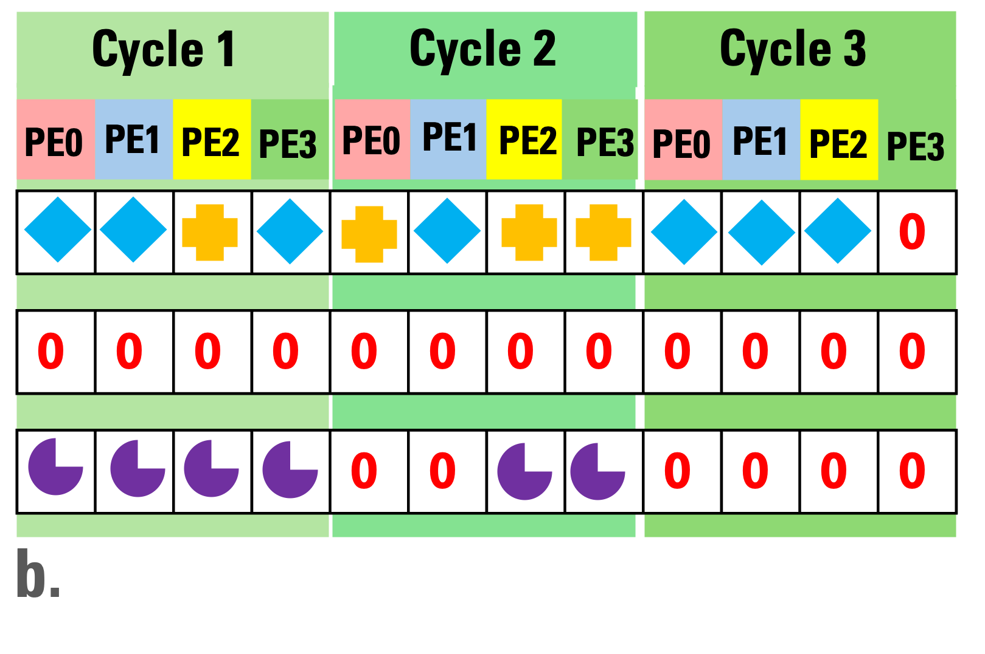
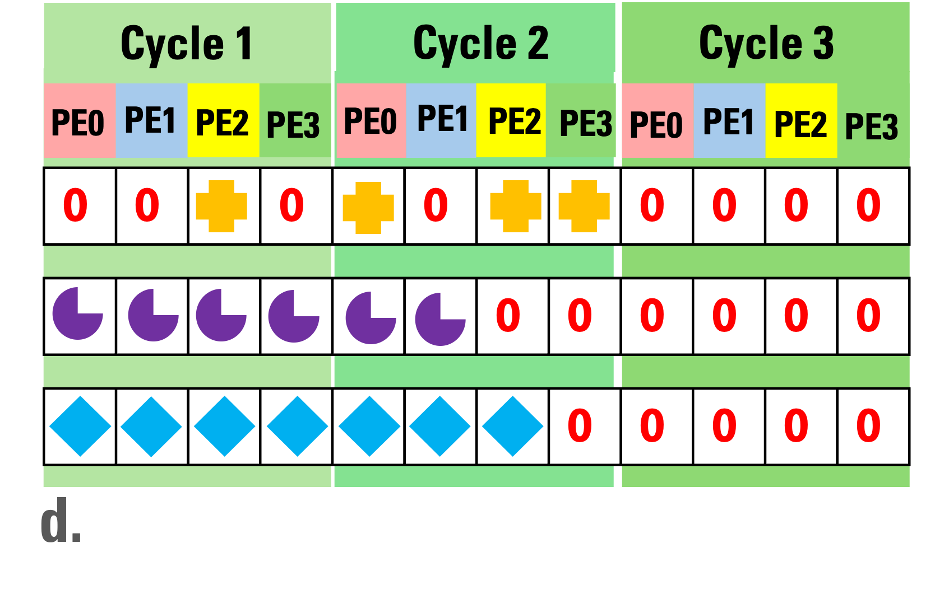
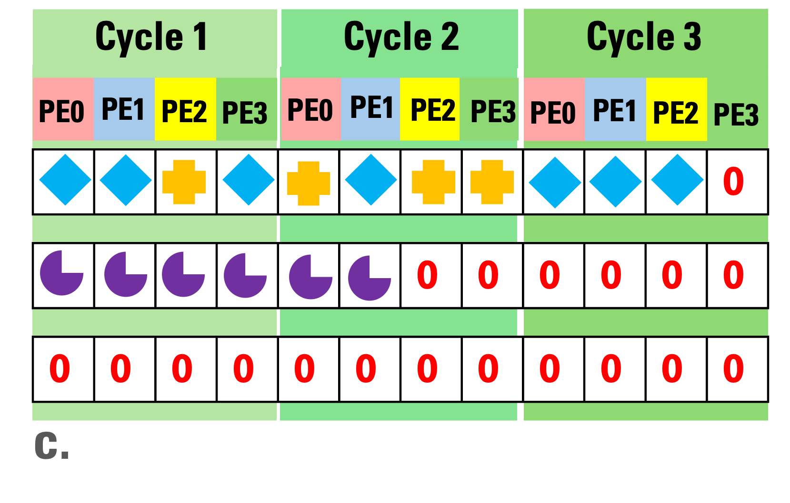
CrHCS - Example
CrHCS on Channel 0
CrHCS on Channel 1
Advantages:
Total stalls reduced from 19 to 7
Total cycles reduced from 3 to 2
CrHCS on Channel 2
Title:
Chasoň
Speaker:
Ubaid Bakhtiar

Slide 41
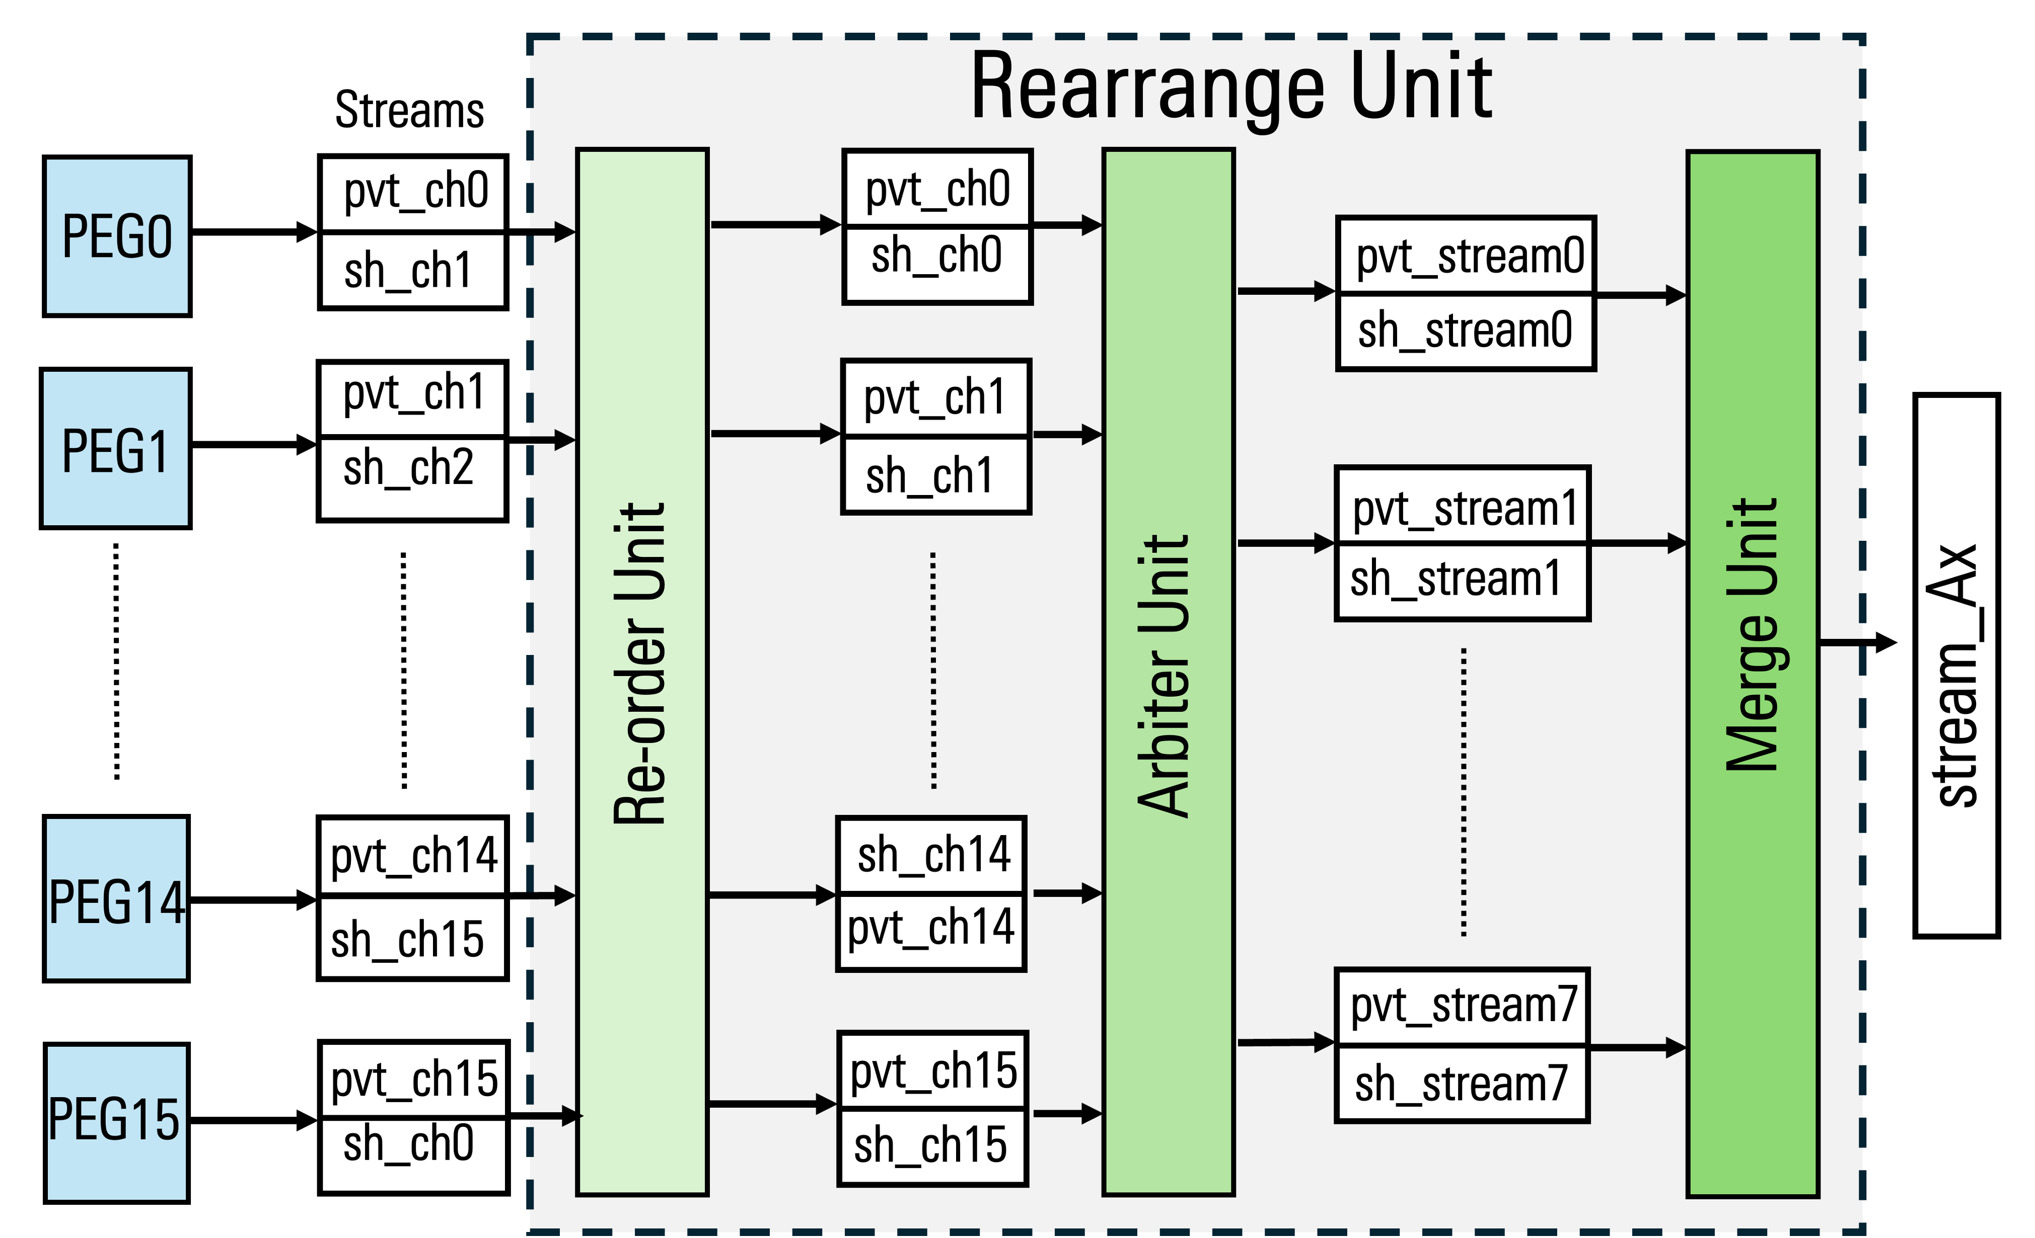
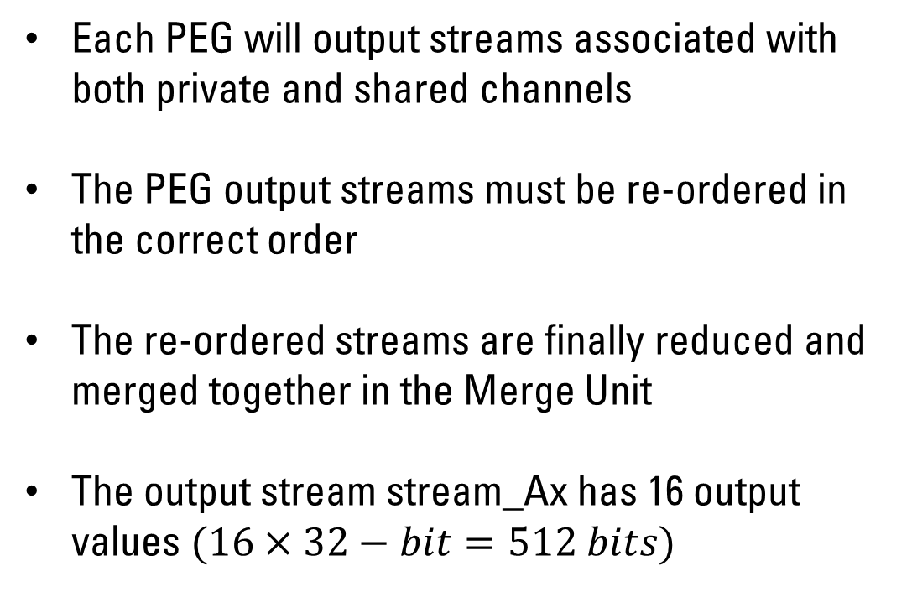
Rearrange Unit
Each PEG will output streams associated with both private and shared channels
The PEG output streams must be re-ordered in the correct order
The re-ordered streams are finally reduced and merged together in the Merge Unit
The output stream stream_Ax has 16 output values $(16×32−bit=512 bits)$
Title:
Chasoň
Speaker:
Ubaid Bakhtiar

Slide 42
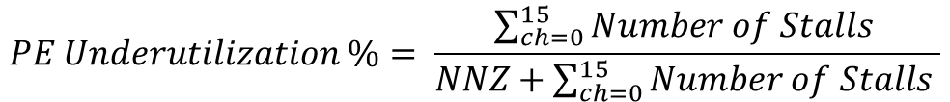
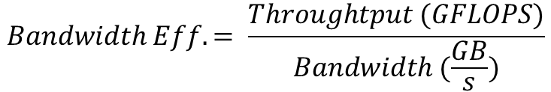
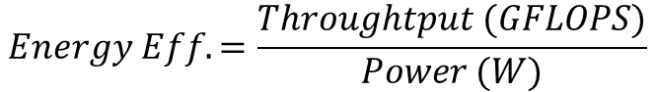
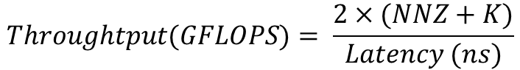
Evaluated Metrics
Latency
Energy Efficiency
Xilinx Run Time
cudaEventElapsedTime
Intel MKL second/dsecnd function
$$Energy Eff. =\frac{Throughtput (GFLOPS)}{Power (W)}$$
Bandwidth Efficiency
$$Bandwidth Eff. = \frac{Throughtput (GFLOPS)}{Bandwidth (\frac{GB}{s})}$$
Throughput
$$Throughtput(GFLOPS)= \frac{2×(NNZ+K)}{Latency (ns)}$$
PE Underutilization
$$PE Underutilization \%= \frac{\sum_{ch=0}^{15}{Number of Stalls }}{NNZ+\sum_{ch=0}^{15}{Number of Stalls }}$$
Title:
Chasoň
Speaker:
Ubaid Bakhtiar

